Slide 1

Lithium Niobate on Insulator Integrated Photonics from Fabrication to Classical and Quantum Applications
Part 1: How LN’s structure leads to its optical properties (Thurs, May 15, 10:45 am – 12:15 pm)
Part 2: Comparison of LN to other materials
(Fri, May 16, 10:45 am – 12:15 pm)
Presenter: Aaron Danner
National University of Singapore
E-mail: adanner@nus.edu.sg
Les Houches School of Physics, France, May 12, 2025 - May 23, 2025
Ecole de Physique des Houches
149 Chemin de la Côte
F-74310 Les Houches

Slide 2
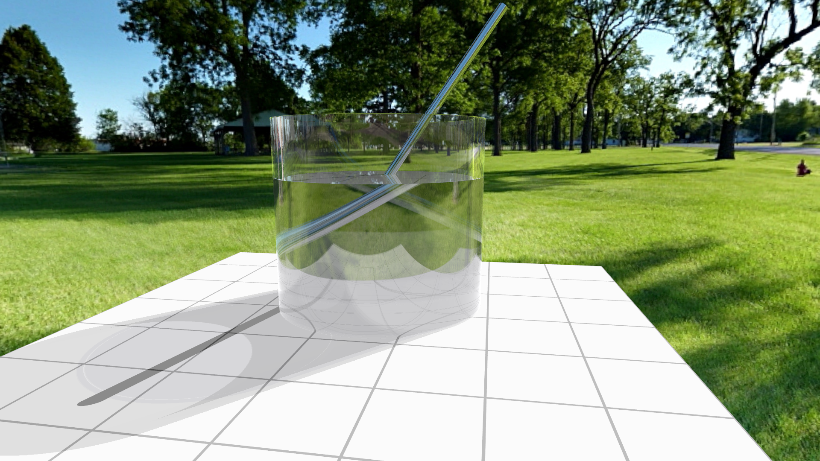
What’s in the glass?
Yes, it is a glass of lithium niobate.

Slide 3

Birefringence in lithium niobate
Actual behavior
Just the ordinary ray

Slide 4
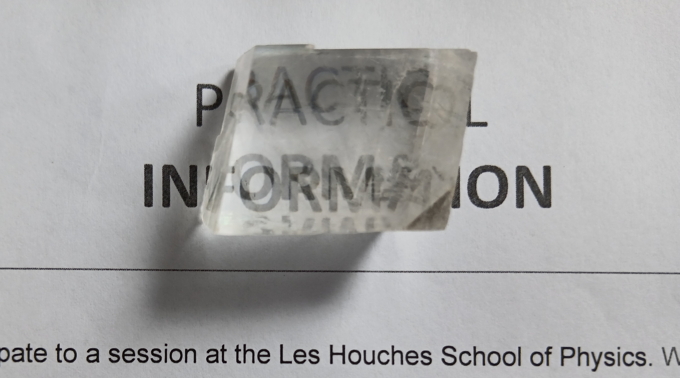
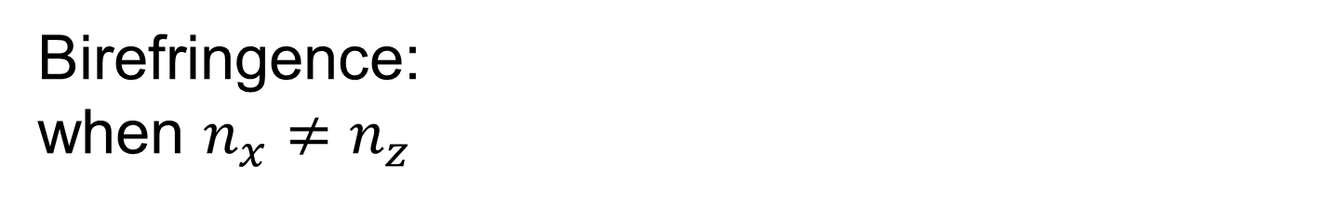

Birefringence: when $n_{x}≠n_{z}$
$$\left(\begin{matrix}D_{x} \\ D_{y} \\ D_{z}\end{matrix}\right)=ε_{0}\left(\begin{matrix}n_{o}^{2} & 0 & 0 \\ 0 & n_{o}^{2} & 0 \\ 0 & 0 & n_{e}^{2}\end{matrix}\right)\left(\begin{matrix}E_{x} \\ E_{y} \\ E_{z}\end{matrix}\right)$$
CALCITE (n_{o}=1.6584 and n_{e}=1.4864)

Slide 5
COMMON UNIAXIAL CRYSTALS
Material | n_{o} | n_{e} | Δn (“birefringence”)
beryl | 1.602 | 1.557 | -0.045
calcite | 1.658 | 1.486 | -0.172
calomel | 1.973 | 2.656 | 0.683
ice | 1.309 | 1.313 | 0.014
lithium niobate | 2.272 | 2.187 | -0.085
magnesium fluoride | 1.38 | 1.385 | 0.006
quartz | 1.544 | 1.553 | 0.009
ruby | 1.77 | 1.762 | -0.008
rutile | 2.616 | 2.903 | 0.287
peridot | 1.69 | 1.654 | -0.036
sapphire | 1.768 | 1.76 | -0.008
sodium nitrate | 1.587 | 1.336 | -0.251
tourmaline | 1.669 | 1.638 | -0.031

Slide 6
In some composite materials, n < 1
GaAs rods in air (TE, d=0.7a)
InGaAs/AlInAs 80 nm, 10¹⁸ (FOM~1000)
Notomi et al., PRB, 62, 10696 (2000) Hoffman et al, Nature Mat., 6, 946 (2007)

Slide 7
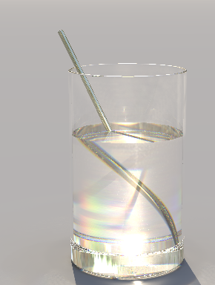
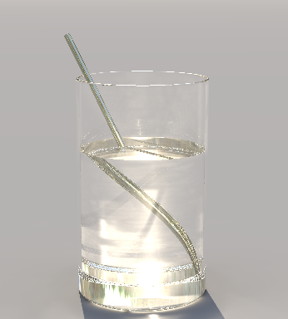
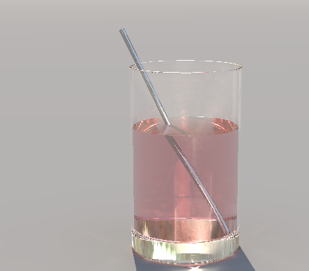
Lithium niobate vs. fruit tea
LITHIUM NIOBATE
n ≅ 2.4
FRUIT TEA
n = 1.3

Slide 8
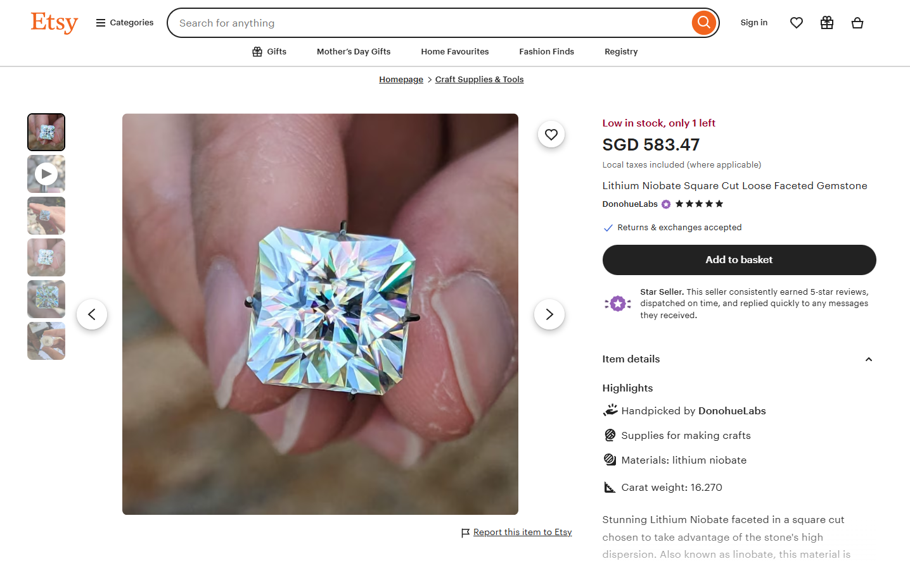
Lithium niobate gemstones exist
Example (May 8, 2025)
https://www.etsy.com/sg-en/listing/1496550454/lithium-niobate-square-cut-loose-faceted?ref=nla_rv-2&sts=1&logging_key=9df04a6e8f76047e403ba472406097889e4c3761%3A1496550454

Slide 9
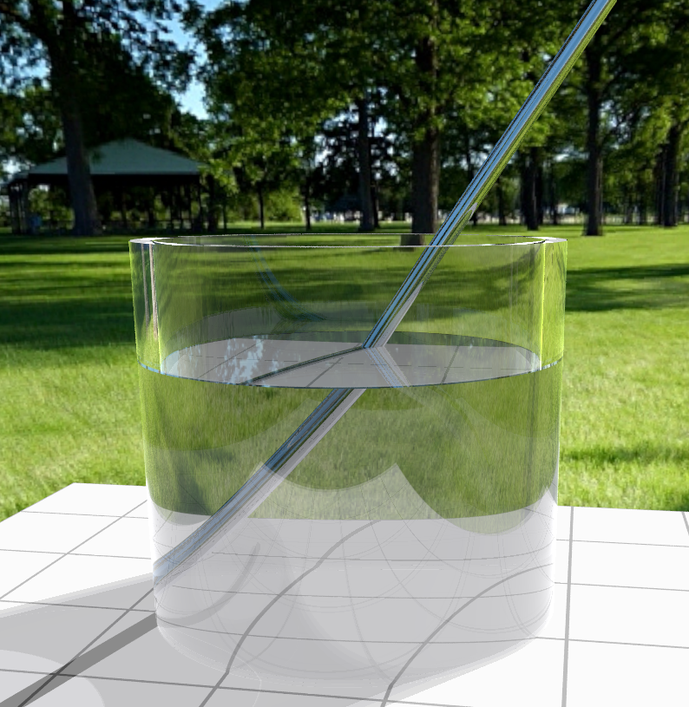
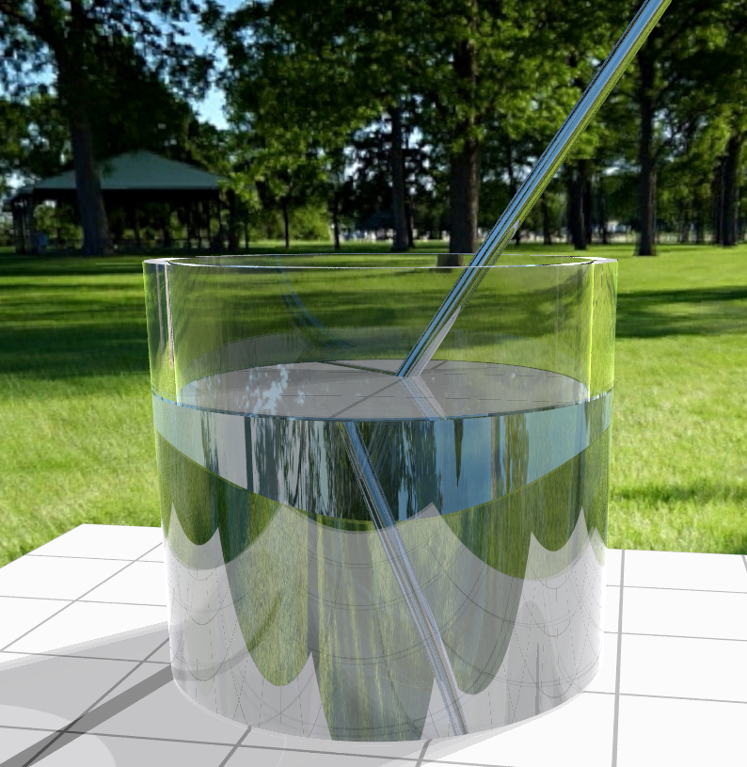
Positive versus negative water
Everything simulated in POV-Ray
Inspired by
Friedrich Lohmuller, 2013
www.f-lohmueller.de
NEGATIVE INDEX WATER
n = -1.33

Slide 10
1. Lithium niobate’s crystal structure
Atomic arrangement
Physical origin of refractive index and birefringence
Physical origin of thermal expansion
Thermo-optics in lithium niobate and silicon
Physical origin of nonlinearity
2. Applications and comparison with other materials
Rotation of crystals and how that affects optics
Barium titanate – growth and fabrication
Optical computing with lithium niobate

Slide 11
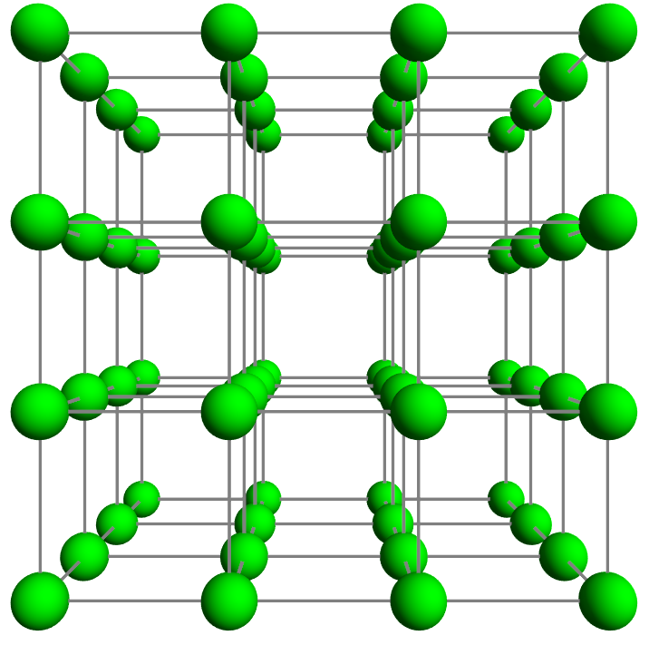






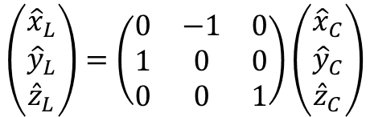






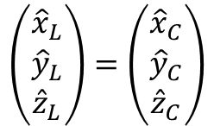

A simple cubic crystal will have isotropic properties.
Looking towards -y
Rotate by 90 degrees
$${\hat{z}}_{C}$$
$${\hat{z}}_{C}$$
$${\hat{x}}_{C}$$
$${\hat{y}}_{C}$$
$$\left(\begin{matrix}{\hat{x}}_{L} \\ {\hat{y}}_{L} \\ {\hat{z}}_{L}\end{matrix}\right)=\left(\begin{matrix}{\hat{x}}_{C} \\ {\hat{y}}_{C} \\ {\hat{z}}_{C}\end{matrix}\right)$$
$$\left(\begin{matrix}{\hat{x}}_{L} \\ {\hat{y}}_{L} \\ {\hat{z}}_{L}\end{matrix}\right)=\left(\begin{matrix}0 & −1 & 0 \\ 1 & 0 & 0 \\ 0 & 0 & 1\end{matrix}\right)\left(\begin{matrix}{\hat{x}}_{C} \\ {\hat{y}}_{C} \\ {\hat{z}}_{C}\end{matrix}\right)$$
$${\hat{y}}_{C}$$
$${\hat{x}}_{C}$$
$${\hat{z}}_{L}$$
$${\hat{z}}_{L}$$
$${\hat{x}}_{L}$$
“the laboratory’s coordinates”
“the crystal’s coordinates”
$${\hat{x}}_{L}$$
$$R$$
$${\hat{y}}_{L}$$
$${\hat{y}}_{L}$$

Slide 12
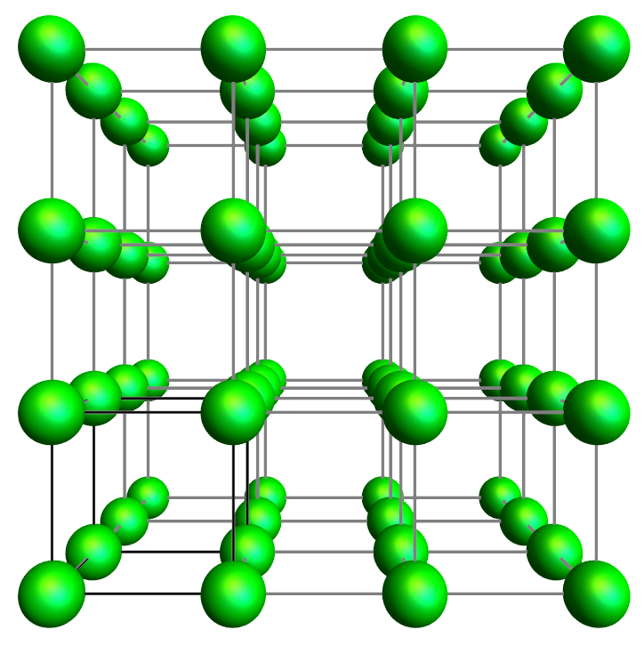
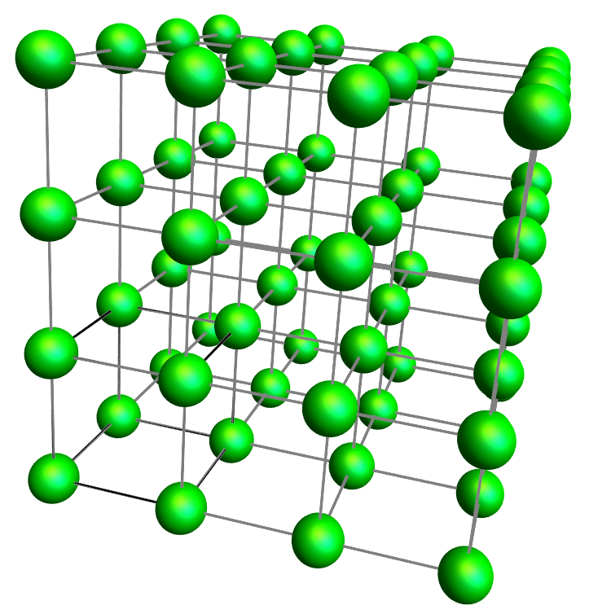








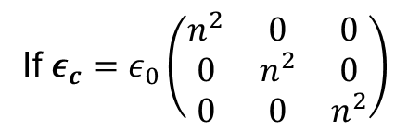







Why is the refractive index the same when you rotate a cubic crystal to any angle?
Apply R
If $ε_{c}=ε_{0}\left(\begin{matrix}n^{2} & 0 & 0 \\ 0 & n^{2} & 0 \\ 0 & 0 & n^{2}\end{matrix}\right)$
$$D=εE$$
$${{(R}^{−1}D}_{L})=ε_{c}(R^{−1}E_{L})$$
$\left(\begin{matrix}D_{x} \\ D_{y} \\ D_{z}\end{matrix}\right)=ε∙$ $\left(\begin{matrix}E_{x} \\ E_{y} \\ E_{z}\end{matrix}\right)$
$${{R(R}^{−1}D}_{L})=Rε_{c}(R^{−1}E_{L})$$
then $ε_{c}=ε_{0}In^{2}$
c
$$D_{L}=(Rε_{c}R^{−1}{)E}_{L}$$
So $ε_{L}=Rε_{c}R^{−1}$
c
c
$$D_{L}=ε_{L}E_{L}$$
$$=Rε_{0}In^{2}R^{−1}$$
$$D_{c}=ε_{c}E_{c}$$
$=ε_{0}RR^{−1}$ $n^{2}$
$$ε_{L}=Rε_{c}R^{−1}$$
$$D_{L}=ε_{L}E_{L}$$
$$=ε_{0}In^{2}$$
$${=ε}_{c}$$

Slide 13
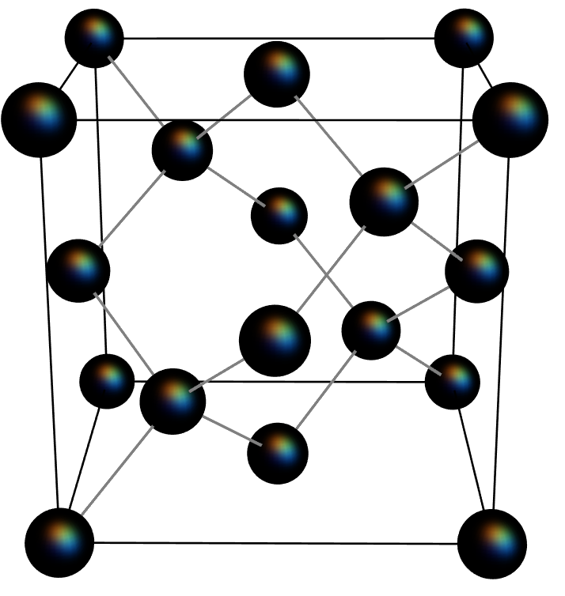
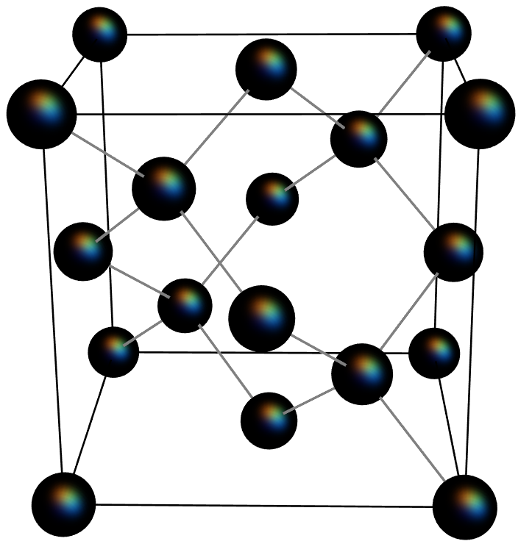
A primitive cell of silicon: Is it really isotropic?
Looking towards +x
Rotate by 90 degrees

Slide 14
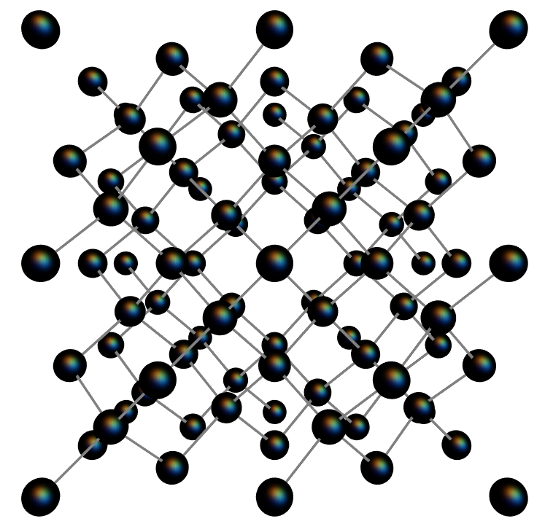
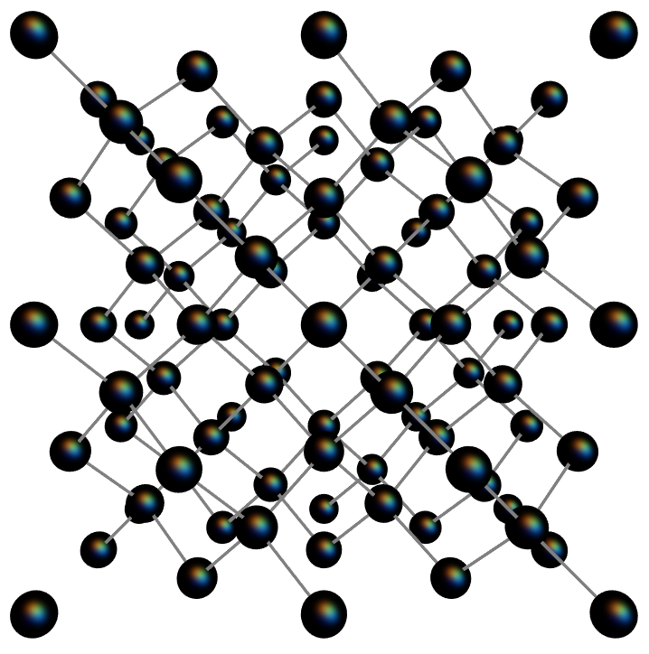
Why silicon is still isotropic
Looking towards +x
Rotate by 90 degrees
AND translate by one atomic bond length
?

Slide 15
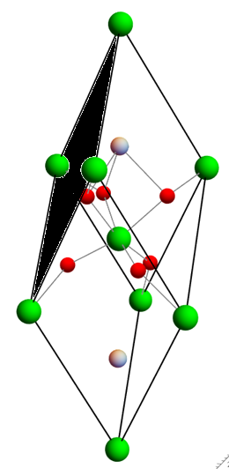
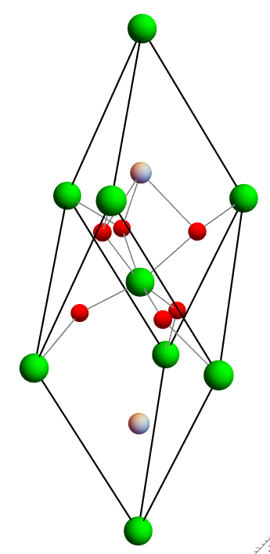
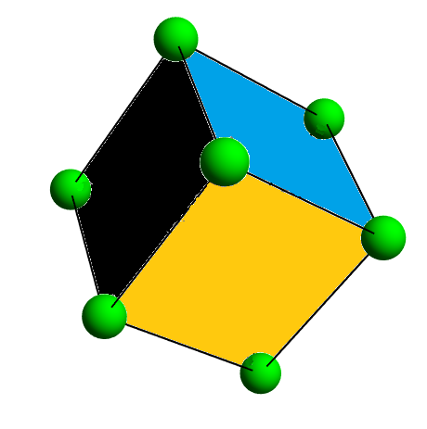
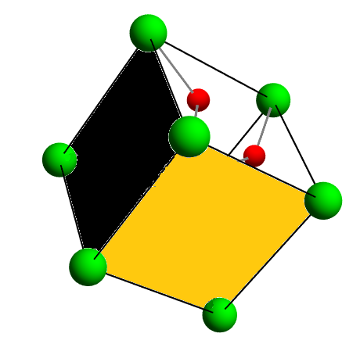
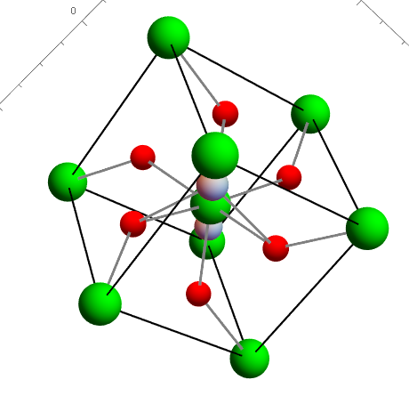
Primitive unit cell of LN
+z
+z

Slide 16
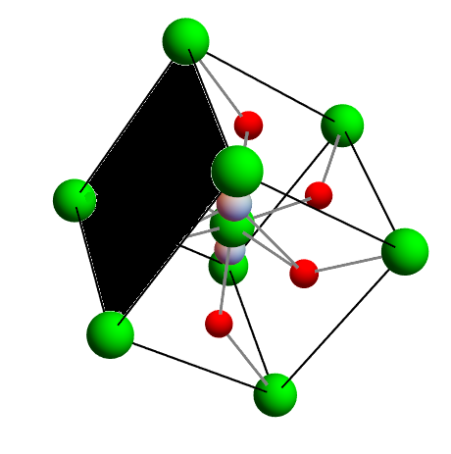
Primitive unit cell of LN
+z
+z

Slide 17
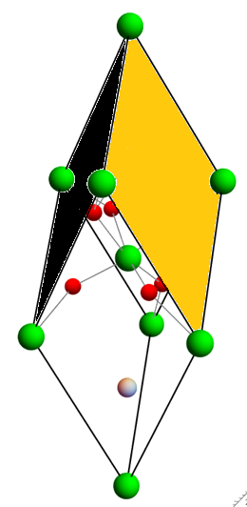
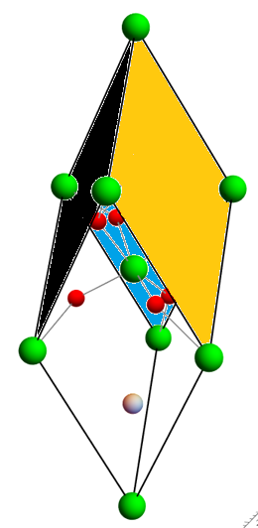
Primitive unit cell of LN
+z
+z

Slide 18
Primitive unit cell of LN
+z
+z

Slide 19
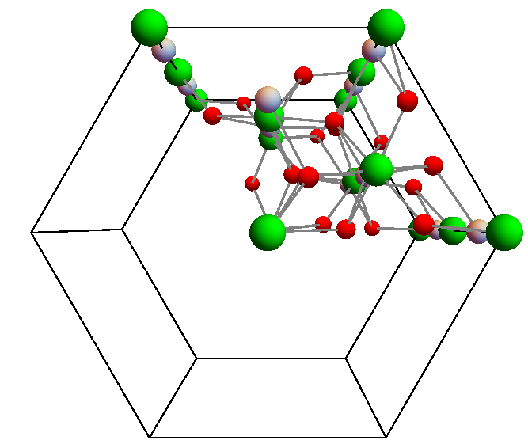
Top view of lithium niobate (crystal class 3m)
120°
Why is LN birefringent?

Slide 20
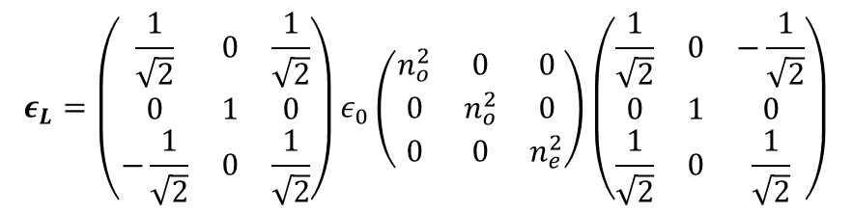
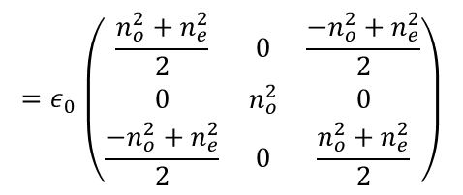


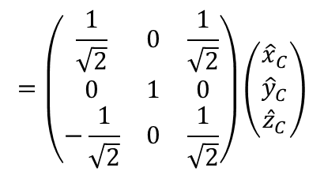
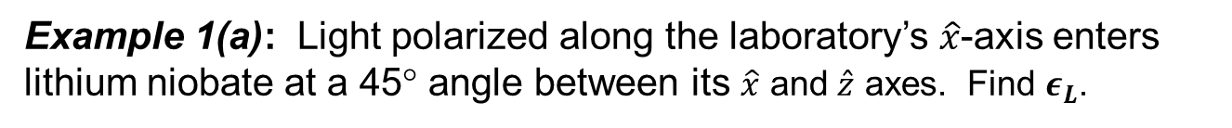

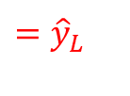

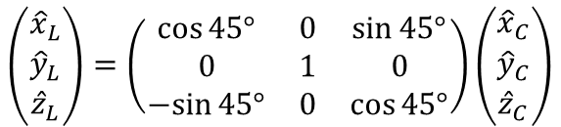

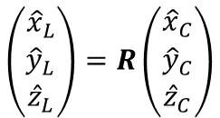
Example 1(a): Light polarized along the laboratory’s $\hat{x}$-axis enters lithium niobate at a 45° angle between its $\hat{x}$ and $\hat{z}$ axes. Find $ε_{L}$.
$$\left(\begin{matrix}{\hat{x}}_{L} \\ {\hat{y}}_{L} \\ {\hat{z}}_{L}\end{matrix}\right)=R\left(\begin{matrix}{\hat{x}}_{C} \\ {\hat{y}}_{C} \\ {\hat{z}}_{C}\end{matrix}\right)$$
$$=\left(\begin{matrix}\frac{1}{\sqrt{2}} & 0 & \frac{1}{\sqrt{2}} \\ 0 & 1 & 0 \\ −\frac{1}{\sqrt{2}} & 0 & \frac{1}{\sqrt{2}}\end{matrix}\right)\left(\begin{matrix}{\hat{x}}_{C} \\ {\hat{y}}_{C} \\ {\hat{z}}_{C}\end{matrix}\right)$$
$$\left(\begin{matrix}{\hat{x}}_{L} \\ {\hat{y}}_{L} \\ {\hat{z}}_{L}\end{matrix}\right)=\left(\begin{matrix}\cos{45°} & 0 & \sin{45°} \\ 0 & 1 & 0 \\ −sin{45°} & 0 & \cos{45°}\end{matrix}\right)\left(\begin{matrix}{\hat{x}}_{C} \\ {\hat{y}}_{C} \\ {\hat{z}}_{C}\end{matrix}\right)$$
$$ε_{L}=Rε_{c}R^{−1}$$
$$ε_{L}=\left(\begin{matrix}\frac{1}{\sqrt{2}} & 0 & \frac{1}{\sqrt{2}} \\ 0 & 1 & 0 \\ −\frac{1}{\sqrt{2}} & 0 & \frac{1}{\sqrt{2}}\end{matrix}\right)ε_{0}\left(\begin{matrix}n_{o}^{2} & 0 & 0 \\ 0 & n_{o}^{2} & 0 \\ 0 & 0 & n_{e}^{2}\end{matrix}\right)\left(\begin{matrix}\frac{1}{\sqrt{2}} & 0 & −\frac{1}{\sqrt{2}} \\ 0 & 1 & 0 \\ \frac{1}{\sqrt{2}} & 0 & \frac{1}{\sqrt{2}}\end{matrix}\right)$$
$${\hat{y}}_{C}$$
$${=\hat{y}}_{L}$$
$${=ε}_{0}\left(\begin{matrix}\frac{n_{o}^{2}+n_{e}^{2}}{2} & 0 & \frac{{−n}_{o}^{2}+n_{e}^{2}}{2} \\ 0 & n_{o}^{2} & 0 \\ \frac{{−n}_{o}^{2}+n_{e}^{2}}{2} & 0 & \frac{n_{o}^{2}+n_{e}^{2}}{2}\end{matrix}\right)$$
$${\hat{x}}_{C}$$
$${\hat{z}}_{C}$$
$${\hat{x}}_{L}$$

Slide 21







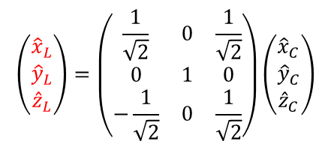



Example 1(b): What happens to the light?
If the light were ${\hat{x}}_{C}$ polarized
$$+y$$
$$E={\hat{x}}_{C}e^{i\frac{{2πn}_{o}}{λ}y}$$
If the light were ${\hat{z}}_{C}$ polarized
$$y=0$$
$$E={\hat{z}}_{C}e^{i\frac{{2πn}_{e}}{λ}y}$$
Here, the light is ${\hat{x}}_{L}$ polarized
$$E={\hat{x}}_{L}e^{i\frac{{2πn}_{??}}{λ}y}$$
$E=\frac{1}{\sqrt{2}}{\hat{x}}_{C}e^{i\frac{{2πn}_{o}}{λ}y}+\frac{1}{\sqrt{2}}{\hat{z}}_{C}$ $e^{i\frac{{2πn}_{e}}{λ}y}$
$$\left(\begin{matrix}{\hat{x}}_{L} \\ {\hat{y}}_{L} \\ {\hat{z}}_{L}\end{matrix}\right)=\left(\begin{matrix}\frac{1}{\sqrt{2}} & 0 & \frac{1}{\sqrt{2}} \\ 0 & 1 & 0 \\ −\frac{1}{\sqrt{2}} & 0 & \frac{1}{\sqrt{2}}\end{matrix}\right)\left(\begin{matrix}{\hat{x}}_{C} \\ {\hat{y}}_{C} \\ {\hat{z}}_{C}\end{matrix}\right)$$
Polarization dispersion
Double refraction
The two components have evolving phase shifts.
$${\hat{y}}_{C}$$
$${=\hat{y}}_{L}$$
$${\hat{x}}_{C}$$
$${\hat{z}}_{C}$$
$${\hat{x}}_{L}$$
${\hat{x}}_{L}=$ $\frac{1}{\sqrt{2}}{\hat{x}}_{C}+\frac{1}{\sqrt{2}}{\hat{z}}_{C}$

Slide 22
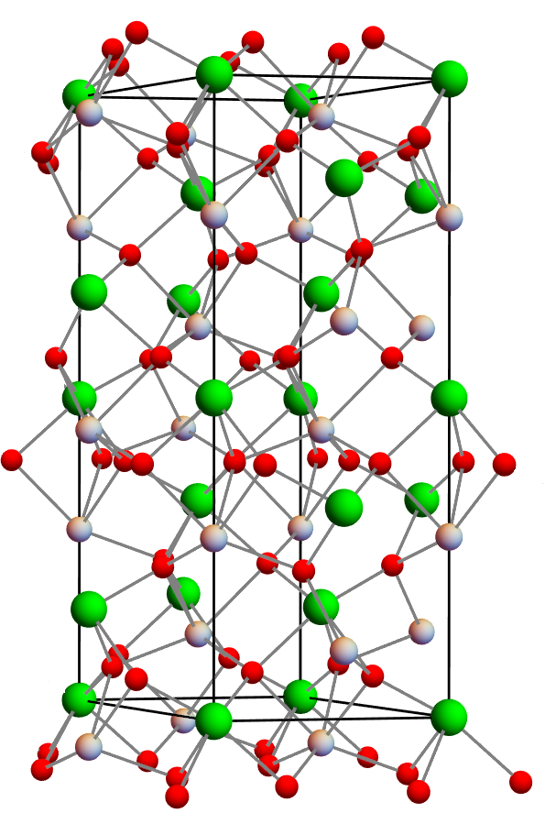
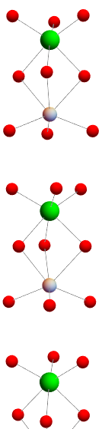
Lithium niobate can be oriented along z
+c
-c
Nb
Nb
Li
Li
Nb
Nb
Li
Li
Nb
Nb

Slide 23
Atomic motion during poling
Original +Z
++++++++
Poled +Z
− − − − − −
+c
Nb⁵⁺
3.051 Å
3.974 Å
Li⁺
High voltage
3.974 Å
3.051 Å
Nb⁵⁺
3.051 Å
Li⁺
3.974 Å
The negative surface oxygen layer here is more easily etched (e.g., in HF:HNO₃ = 1:2) because the oxygen atoms are farther apart.
− − − − − −
++++++++
Spacings from X. Zhang et al., Materials Science and Engineering B, 120 (2005) 21-26.

Slide 24
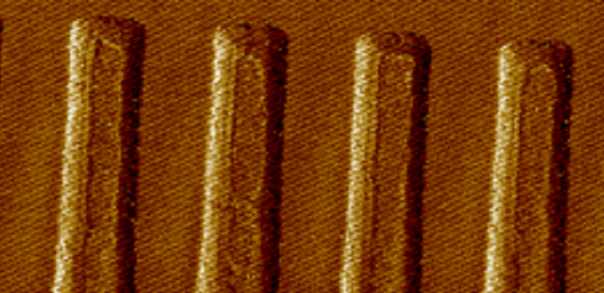
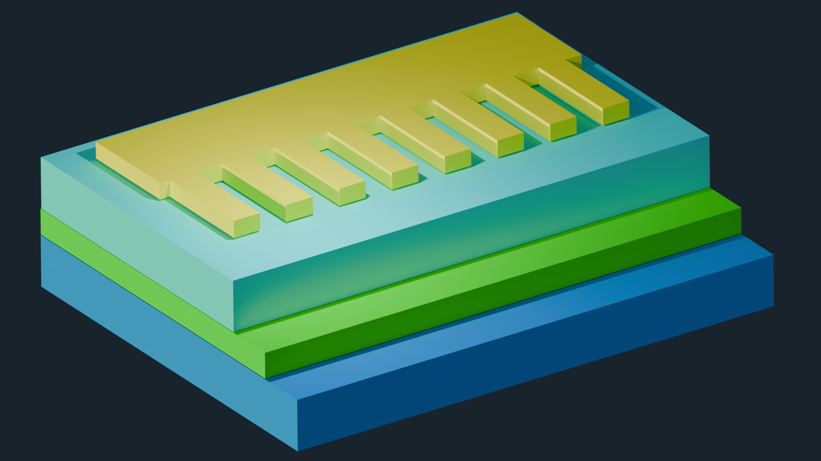
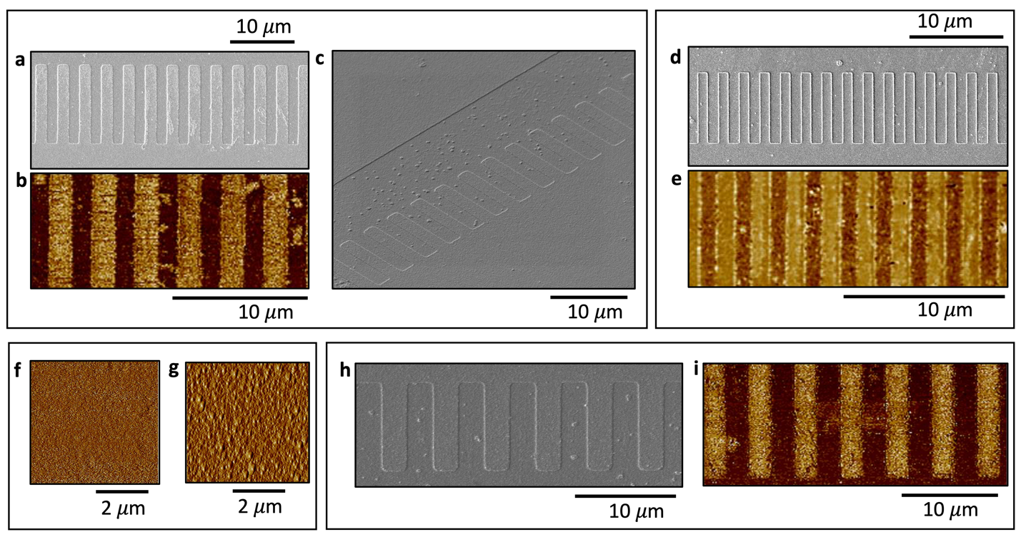
Periodic poling of barium titanate
z
0.5 𝜇m
y
x
BTO
SRO
BTO
BTO
50 nm
DSO
SRO
DSO
DSO
P. Aashna, H.-L. Lin, Y. Cao, Y. Yin, Y. Gao, S. S. Mohanraj, D. Zhu, A. Danner, Periodic Domain Inversion in Single Crystal Barium Titanate-on-Insulator Thin Film. Adv. Sci. 2024, 11, 2406248. https://doi.org/10.1002/advs.202406248

Slide 25
What causes refractive index?

Slide 26
Refractive indices of a few materials
Material | n (at 589 nm)
Air | 1.00029
Ice | 1.31
Water | 1.333
Ethyl alcohol | 1.36
Fused quartz | 1.4584
Carbon tetrachloride | 1.46
Turpentine | 1.472
Benzene | 1.501
Plexiglass | 1.51
Crown glass | 1.52
Sodium chloride | 1.544
Light flint glass | 1.58
Polystyrene | 1.59
Carbon disulfide | 1.628
Dense flint glass | 1.66
Lanthanum flint glass | 1.80
Zircon | 1.923
Diamond | 2.417
Rutile | 2.907
Gallium phosphide | 3.45
Solid sodium metal | 0.04 – i2.4
Tin | 1.5 – i5.3

Slide 27
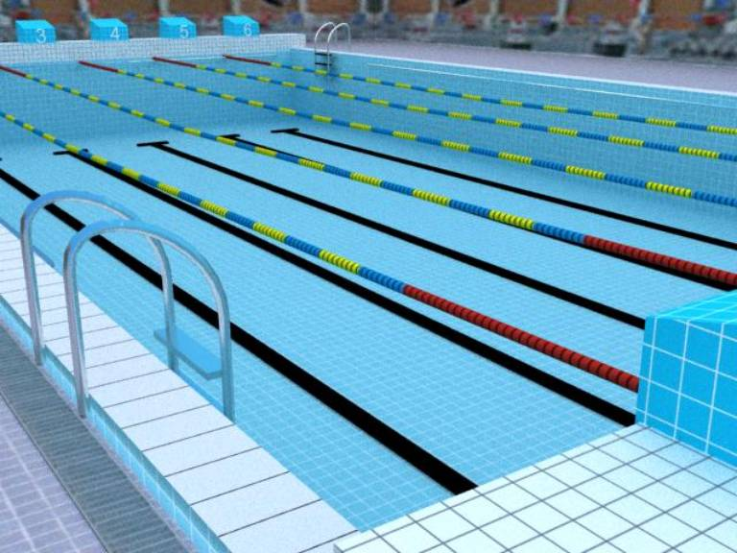
An empty swimming pool (air, n = 1)

Slide 28
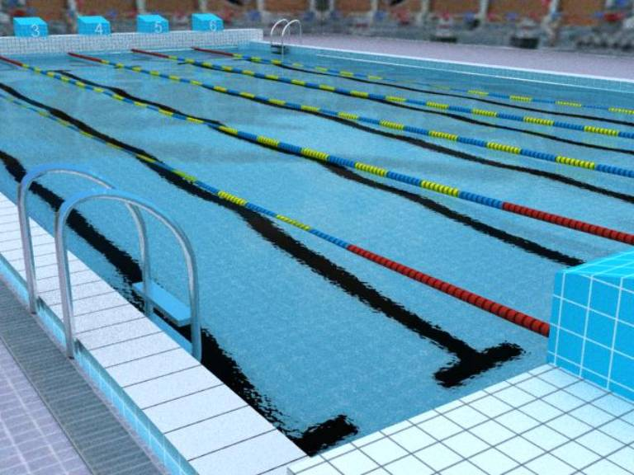
Water (n = +1.33)

Slide 29
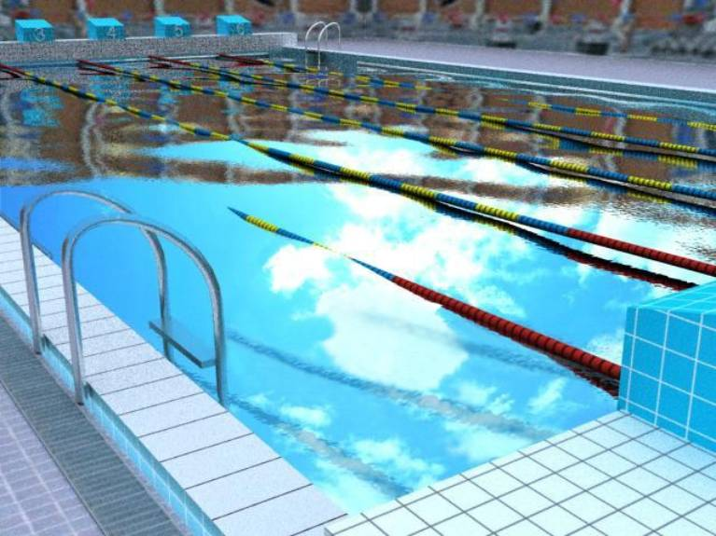
n = 0.9 (field of view near critical angle)

Slide 30
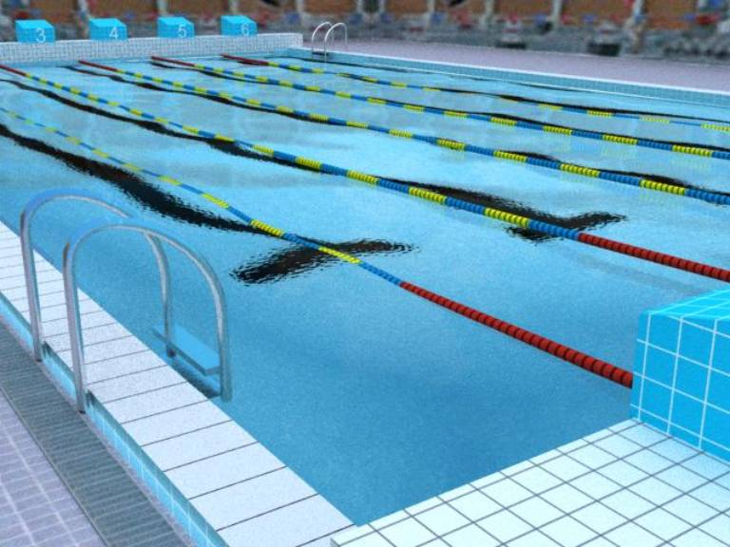
n = -1.33

Slide 31

n = -1.33

Slide 32
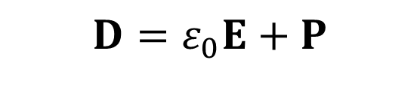
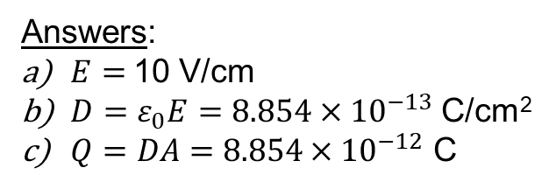
A review of Maxwell’s variables: Free space
$$D=ε_{0}E+P$$
Electric displacement field [C/m²]
Material polarization [C/m²]
Permittivity of free space [ϵ₀​=8.854×10⁻¹² F/m]
Electric field [V/m]
Example 2(a): Free space
(C=0.885 pF)
Imagine 10V applied to a plate capacitor. The plates are 1 cm apart and they are 10 cm² in surface area each.
  What’s the electric field E between the plates?
  What is D?
  What is the total charge on either plate?
10V
+
-
Answers:
$E=$10 V/cm
${D=ε}_{0}E=8.854×{10}^{−13}$ C/cm²
$Q=DA=$ $8.854×{10}^{−12}$ C

Slide 33
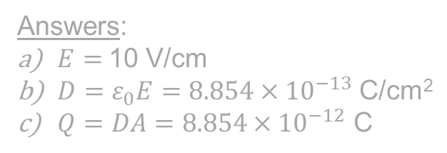


A review of Maxwell’s variables: Free space
$$D=ε_{0}E+P$$
Electric displacement field [C/m²]
Material polarization [C/m²]
Permittivity of free space [ϵ₀​=8.854×10⁻¹² F/m]
Electric field [V/m]
Example 2(b): Free space
(C=1.77 pF)
Imagine 10V applied to a plate capacitor. The plates are 1 cm apart and they are 10 20 cm² in surface area each.
  What’s the electric field E between the plates?
  What is D?
  What is the total charge on either plate?
10V
+
-
Answers:
$E=$10 V/cm
${D=ε}_{0}E=8.854×{10}^{−13}$ C/cm²
$Q=DA=8.854×{10}^{−12} \text{C}$
$E=$10 V/cm
${D=ε}_{0}E=8.854×{10}^{−13}$ C/cm²
$17.7×{10}^{−12}$ C
D is quite simple: How much charge is on one plate?

Slide 34







A review of Maxwell’s variables: Dielectric
(an insulator)
$$D=ε_{0}E+P$$
$D=ε_{0}E+P=$ $ε_{0}ε_{r}E$
Electric displacement field [C/m²]
Permittivity of free space [ϵ₀​=8.854×10⁻¹² F/m]
Material polarization [C/m²]
Electric field [V/m]
Example 2(c): Fused Quartz ($ε_{r}=$3.7 at DC)
(C=6.55 pF)
Imagine 10V 2.7 V applied to a plate capacitor. The plates
are 1 cm apart and they are
10 20 cm² in surface area each.
  What’s the electric
  field E between the plates?
  What is D?
  What is the total
  charge on
  either plate?
2.7V
+
-
Answers:
$E=$10 V/cm
${D=ε}_{0}ε_{r}E=8.854×{10}^{−13}$ C/cm²
$Q=DA=8.854×{10}^{−12} \text{C}$
$$2.7 V/cm$$
(We kept D the same.)
$8.854×{10}^{−13}$ C/cm²
$17.7×{10}^{−12}$ C
$17.7×{10}^{−12}$ C
(Same charge, less field E.)

Slide 35



The situation between the plates with dielectric
WITH NO APPLIED FIELD
P = 0
The charges are still bound, but they separated a little.
WITH APPLIED FIELD
The applied voltage is the same, but the field between the plates is reduced a little, due to the charge separation there.
+
-
+
-
Observation: Refractive index is related to charge separation.
+
-
P > 0
$$D=ε_{0}E+P={ε_{0}ε}_{r}E$$
P can be thought of
as “dipoles per unit volume”
= dipoles (C m) / volume (m³).
Electric displacement field [C/m²]
$$ε_{r}=1+\frac{P}{ε_{0}E}$$
$$P\sim Nex$$

Slide 36











Atomic forces versus force from light
How does the atomic field compare to the field from passing light?
a) In a Bohr atom:
($r=5.29×{10}^{−11}$ m)
$$E=\frac{F}{e}=\frac{e}{4πε_{0}r^{2}}$$
Answer:
$E=\frac{1.6×{10}^{−19}}{4π\left(8.85 ×{10}^{−12}\right){\left(5.29×{10}^{−11}\right)}^{2}}$ V/m
$=5.14×{10}^{11}$ $V/m$
b) Red laser pointer:
(5 mW power,
2.5 mm beam radius)
$$I= \frac{Power}{Beam Area}$$
$= \frac{0.005}{π{\left(0.0025\right)}^{2}} W/m^{2}$ = 255 $W/m^{2}$
$$I=\frac{1}{2}ε_{0}cE^{2}$$
$$E=\sqrt{\frac{2I}{ε_{0}c}}$$
$=\sqrt{\frac{2(255)}{\left(8.85 ×{10}^{−12}\right)\left(3 ×{10}^{8}\right)}}$ $V/m$
$$=438 V/m$$

Slide 37







Forces inside a solid
1. Let’s model an electron inside a solid.
5. If the displacement is small:
$$F_{r}(∆x)=−\frac{x_{0}e^{2}(∆x)}{ε_{0}{π\left(x_{0}^{2}−(∆{x)}^{2}\right)}^{2}}$$
$$≈F_{r}\left(0\right)+\frac{dF_{r}}{d\left(∆x\right)} ∙∆x$$
$$∆x=0$$
2. Let’s displace the electron.
$$≈−\frac{e^{2}}{ε_{0}πx_{0}^{3}}∆x$$
constant k
3. Find the restoring force.
$$F_{r}\left(∆x\right)=+\frac{e^{2}}{4πε_{0}{\left(x_{0}+∆x\right)}^{2}}−\frac{e^{2}}{4πε_{0}{\left(x_{0}−∆x\right)}^{2}}$$
$$=−\frac{x_{0}e^{2}(∆x)}{ε_{0}π{\left(x_{0}^{2}−(∆{x)}^{2}\right)}^{2}}$$

Slide 38











Linear model
Restoring force + Applied force = ma
-
+
-
+
-
+
$−kx+eE=ma$
P > 0
If the applied force is DC
If the applied force is AC
$$E=E_{DC}$$
$$E=E_{0}\cos{ωt}$$
$$−kx+eE_{DC}=m\frac{d^{2}x}{dt^{2}}$$
$$−kx+eE_{0}\cos{ωt}=m\frac{d^{2}x}{dt^{2}}$$
$$−kx+eE_{DC}=0$$
$$x=\frac{eE_{0}}{k−mω^{2}}\cos{ωt}$$
$$x=\frac{eE_{DC}}{k}$$
Observations:
$x$is proportional to $E_{0}$
$ε_{r}=\frac{Ne}{ε_{0}}\frac{e}{k−mω^{2}}+1$
Refractive index depends on frequency
(We get a small constant electron displacement).
$$ε_{r}=1+\frac{P }{ε_{0}E}$$
$$=1+\frac{ Nex}{ε_{0}E_{0}\cos{ωt}}$$

Slide 39





What if you have both DC and AC fields?
Restoring force + Applied force = ma
$−kx+eE=ma$
+
-
+
-
+
-
External voltage
Light
P > 0
$$E={E_{DC}+E}_{0}\cos{ωt}$$
Solution:
$$x=\frac{eE_{DC}}{k}$$
$$+\frac{eE_{0}}{k−mω^{2}}\cos{ωt}$$
Observation: Refractive index does not depend on $E_{DC}$, but k may be direction-dependent.
(a DC field just shifts the graph)

Slide 40






Electron movement and refractive index
Restoring force + Applied force = ma
Refractive index depends on:
average atomic separation
frequency
density of dipoles
$−kx+eE=ma$
External voltage
Light
Light intensity
DC field strength
$$E={E_{DC}+E}_{0}\cos{ωt}$$
Solution:
$$x=\frac{eE_{DC}}{k}$$
$$+\frac{eE_{0}}{k−mω^{2}}\cos{ωt}$$
nonlinear
optics
$$F_{r}(∆x)=−\frac{x_{0}e^{2}(∆x)}{ε_{0}{\left(x_{0}^{2}−(∆{x)}^{2}\right)}^{2}}$$
$$≈−\frac{e^{2}}{ε_{0}πx_{0}^{3}}∆x$$
$≈−k∆x$
linear
optics
$$=−\frac{dV}{dx}$$
“Lorentz Oscillator Model”

Slide 41
Electrically changing the refractive index
Thermo-optically
  In silicon, the change is of index near room temperature is 1.86 × 10⁻⁴ /K
Carrier injection
  In silicon, for light at 1.55 μm wavelength, if ΔN_{e}=ΔN_{h}=10¹⁸ cm⁻³, then Δn = -1.1 × 10⁻³ and α = 14.5 cm⁻¹.
  Optical loss is impossible to eliminate.
Kerr effect (apply a voltage)
  In silicon, Δn = 10⁻⁴ at a field of 1000 kV/cm = 100 V/μm
Pockels effect (apply a voltage to a nonlinear material)
  Not available in silicon or any other centrosymmetric crystal
  In lithium niobate, Δn = 10⁻⁴ at a field of 6.3 V/μm = 62.6 kV/cm
  (63 V/μm is needed to get a Δn = 10⁻³)
  It’s fast.

Slide 42


A more realistic potential
Orbital model
Linear model
Towards proton
Away from
proton

Slide 43






Temperature dependence of lattice constants in LN
$$\frac{∆n_{e}}{∆T}≈4 ×{10}^{−5}$$
$$∆a/a$$
$$∆c/c$$
$$\frac{∆n_{o}}{∆T}≈ 2.5 ×{10}^{−5}$$
References, compiled by Minghao Shang, Ph.D. student
[1] Journal of Physics and Chemistry of Solids, 1966, 27(6-7): 1019-1026.
[2] IEEE International Conference on Oxide Materials for Electronic Engineering (OMEE). IEEE, 2012: 147-148.
[3] Journal of Crystal Growth, 1976, 33(1): 199-202.
[4] Materials, 2022, 15(13): 4716.
[5] L. Moretti et al., “Temperature dependence of the thermo-optic coefficient of lithium niobate, from 300 to 515 K in the
visible and infrared regions,” J. Appl. Phys. 98(3), 036101 (2005).

Slide 44








Example 3 (thermo-optics): In lithium niobate, TM light from a single laser at λ = 1.55 μm is split and follows two paths, each 1 mm long, and then the light recombines. One path is at room temperature (300 K). How much must the second path be heated if the light will recombine with destructive interference?
$$\frac{∆n}{∆T}=4×{10}^{−5}$$
Solution
Path 1
Combined field
$$E_{1 }\sim e^{i\frac{{2πn}_{1}}{λ}x}$$
$E_{1}+E_{2} \sim e^{i\frac{{2πn}_{1}}{λ}x}$ + $e^{i\frac{{2πn}_{2}}{λ}x}$
$$∆n =\frac{λ}{2x}=0.000775$$
Path 2
$$\sim e^{i\frac{{2πn}_{1}}{λ}x}\left(1\text{+ }e^{i\frac{{2π(n}_{2}−n_{1})}{λ}x}\right)$$
$$∆T=19.4 K$$
$$E_{2 }\sim e^{i\frac{{2πn}_{2}}{λ}x}$$
$$\frac{2π∆n}{λ}x=π$$

Slide 45

Thermo-Optic Mach-Zehnder interferometer
Tuning efficiency = 0.59 nm/V
G. Chen et al., “Integrated thermally tuned mach-zehnder interferometer in Z-cut lithium niobate thin film,” IEEE Photonics
Technol. Lett. 33(13), 664–667 (2021).

Slide 46
Thermo-Optic Mach-Zehnder interferometer with air bridges
G. Chen, H.-L. Lin and A. J. Danner, "Highly Efficient Thermal Tuning Interferometer in Lithium Niobate Thin Film Using Air Bridge," IEEE Photonics J., vol. 13, no. 3, pp. 1-9, 2021.

Slide 47



Pockels effect in lithium niobate
Apply a DC field in the z-direction:
An applied field along z
$$ε=ε_{0}\left[\begin{matrix}n_{0}^{2}−n_{0}^{4}r_{13}E_{Z} & 0 & 0 \\ 0 & n_{0}^{2}−n_{0}^{4}r_{13}E_{Z} & 0 \\ 0 & 0 & n_{e}^{2}−n_{e}^{4}r_{33}E_{Z}\end{matrix}\right]$$
r₃₃
affecting z-polarization
where r₁₃=8.6 pm/V, r₃₃=30.8 pm/V, r₂₂ = r₅₁ = 3.4 pm/V, r₆₁ = -r₂₂,
n₀=2.238 and n_{e}=2.159.
Apply a DC field in the x-direction:
$$ε=ε_{0}\left[\begin{matrix}n_{0}^{2} & {−n}_{0}^{4}r_{61}E_{x} & {−n}_{0}^{2}{n_{e}^{2}r}_{51}E_{x} \\ {−n}_{0}^{4}r_{61}E_{x} & n_{0}^{2} & 0 \\ {−n}_{0}^{2}{n_{e}^{2}r}_{51}E_{x} & 0 & n_{e}^{2}\end{matrix}\right]$$
General case:
$$ε=ε_{0}\left(\begin{matrix}n_{x}^{2}−n_{x}^{4}\sum_{k}{r_{1k}E_{k}} & −n_{x}^{2}n_{y}^{2}\sum_{k}{r_{6k}E_{k}} & −n_{x}^{2}n_{z}^{2}\sum_{k}{r_{5k}E_{k}} \\ −n_{x}^{2}n_{y}^{2}\sum_{k}{r_{6k}E_{k}} & n_{y}^{2}−n_{y}^{4}\sum_{k}{r_{2k}E_{k}} & −n_{y}^{2}n_{z}^{2}\sum_{k}{r_{4k}E_{k}} \\ −n_{x}^{2}n_{z}^{2}\sum_{k}{r_{5k}E_{k}} & −n_{y}^{2}n_{z}^{2}\sum_{k}{r_{4k}E_{k}} & n_{z}^{2}−n_{z}^{4}\sum_{k}{r_{3k}E_{k}}\end{matrix}\right)$$

Slide 48


Z-cut modulator
G. Chen, H. -L. Lin, J. D. Ng and A. J. Danner, "Integrated Electro-Optic Modulator in Z-Cut Lithium Niobate Thin Film With Vertical Structure," IEEE Photonics Technol. Lett., vol. 33, no. 23, pp. 1285-1288, 2021.

Slide 49





Example 4: A DC field $E_{x}$ is applied to barium titanate, a 4mm crystal with r₁₃ = r₂₃ = 19.5 pm/V, r₃₃ = 97 pm/V, r₄₂ = r₅₁ =1640 pm/V.
n_{o} = 2.488 n_{e} = 2.424. Find $ε_{c}$.
$$ε=ε_{0}\left(\begin{matrix}n_{x}^{2}−n_{x}^{4}\sum_{k}{r_{1k}E_{k}} & −n_{x}^{2}n_{y}^{2}\sum_{k}{r_{6k}E_{k}} & −n_{x}^{2}n_{z}^{2}\sum_{k}{r_{5k}E_{k}} \\ −n_{x}^{2}n_{y}^{2}\sum_{k}{r_{6k}E_{k}} & n_{y}^{2}−n_{y}^{4}\sum_{k}{r_{2k}E_{k}} & −n_{y}^{2}n_{z}^{2}\sum_{k}{r_{4k}E_{k}} \\ −n_{x}^{2}n_{z}^{2}\sum_{k}{r_{5k}E_{k}} & −n_{y}^{2}n_{z}^{2}\sum_{k}{r_{4k}E_{k}} & n_{z}^{2}−n_{z}^{4}\sum_{k}{r_{3k}E_{k}}\end{matrix}\right)$$
$$=ε_{0}\left(\begin{matrix}n_{x}^{2}−n_{x}^{4}r_{11}E_{x} & −n_{x}^{2}n_{y}^{2}r_{61}E_{x} & −n_{x}^{2}n_{z}^{2}r_{51}E_{x} \\ −n_{x}^{2}n_{y}^{2}r_{61}E_{x} & n_{y}^{2}−n_{y}^{4}r_{21}E_{x} & −n_{y}^{2}n_{z}^{2}r_{41}E_{x} \\ −n_{x}^{2}n_{z}^{2}r_{51}E_{x} & −n_{y}^{2}n_{z}^{2}r_{41}E_{x} & n_{z}^{2}−n_{z}^{4}r_{31}E_{x}\end{matrix}\right)$$
$$=ε_{0}\left(\begin{matrix}n_{x}^{2} & 0 & −n_{x}^{2}n_{z}^{2}r_{51}E_{x} \\ 0 & n_{y}^{2} & 0 \\ −n_{x}^{2}n_{z}^{2}r_{51}E_{x} & 0 & n_{z}^{2}\end{matrix}\right)$$
$$=ε_{0}\left(\begin{matrix}n_{o}^{2} & 0 & −n_{o}^{2}n_{e}^{2}r_{51}E_{x} \\ 0 & n_{o}^{2} & 0 \\ −n_{o}^{2}n_{e}^{2}r_{51}E_{x} & 0 & n_{e}^{2}\end{matrix}\right)$$

Slide 50




What other crystals give diagonal elements?
$$∆ε_{ij}=−n_{i}^{2}n_{j}^{2}∆_{ij}$$
$$Δη_{jk}→Δη_{l}$$
jk
xx or 11 | 1
yy or 22 | 2
zz or 33 | 3
yz, zy, 23 or 32 | 4
xz, zx, 13 or 31 | 5
xy, yx, 12 or 21 | 6

Slide 51

What other crystals give diagonal elements?
$$∆ε_{ij}=−n_{i}^{2}n_{j}^{2}∆_{ij}$$
$$Δη_{jk}→Δη_{l}$$
jk
xx or 11 | 1
yy or 22 | 2
zz or 33 | 3
yz, zy, 23 or 32 | 4
xz, zx, 13 or 31 | 5
xy, yx, 12 or 21 | 6

Slide 52


NUS Solar Quadcopter Team (2018)
https://www.youtube.com/watch?v=bJPplmWb-vI

