Slide 1


Lithium Niobate on Insulator Integrated Photonics from Fabrication to Classical and Quantum Applications
Part 1: How LN’s structure leads to its optical properties (Thurs, May 15, 10:45 am – 12:15 pm)
Part 2: Comparison of LN to other materials
(Fri, May 16, 10:45 am – 12:15 pm)
Presenter: Aaron Danner
National University of Singapore
E-mail: adanner@nus.edu.sg
Les Houches School of Physics, France, May 12, 2025 - May 23, 2025
Ecole de Physique des Houches
149 Chemin de la Côte
F-74310 Les Houches

Slide 2
If you have many randomly oriented sub-wavelength lithium niobate domains, what will happen optically?
There will be an effective refractive index (the macroscopic crystal now appears isotropic)
The Pockels effect disappears (because now we have inversion symmetry)

Slide 3
Lithium niobate publication counting
First
try at NUS
[1] J. Deng, G. Si and A. J. Danner, "Dry etching of LiNbO₃ using inductively coupled plasma," 2010 Photonics Global Conference, Orchard, Singapore, 2010, pp. 1-5, doi: 10.1109/PGC.2010.5706006.
[2] Jun Deng, Sajid Hussain, Vanga Sudheer Kumar, Wei Jia, Ching Eng Png, Lim Soon Thor, Andrew A. Bettiol, and Aaron J. Danner, "Modeling and experimental investigations of Fano resonances in free-standing LiNbO₃ photonic crystal slabs," Opt. Express 21, 3243-3252 (2013)
[3] Deng Jun, Jia Wei, Ching Eng Png, Si Guangyuan, Jaesung Son, Hyunsoo Yang, Aaron J. Danner; Deep anisotropic LiNbO₃ etching with SF₆/Ar inductively coupled plasmas. Journal of Vacuum Science & Technology B 1 January 2012; 30 (1): 011208. https://doi.org/10.1116/1.3674282

Slide 4
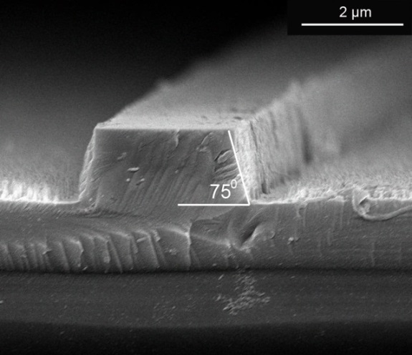
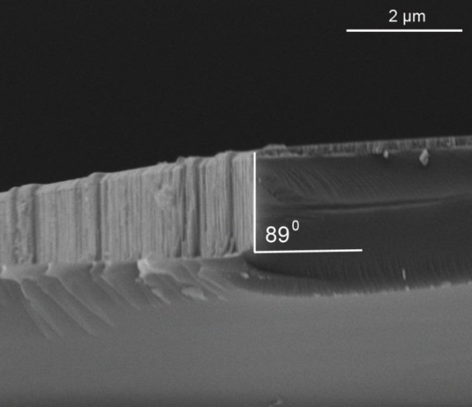
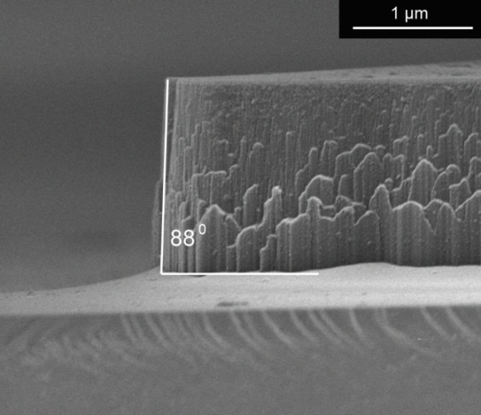

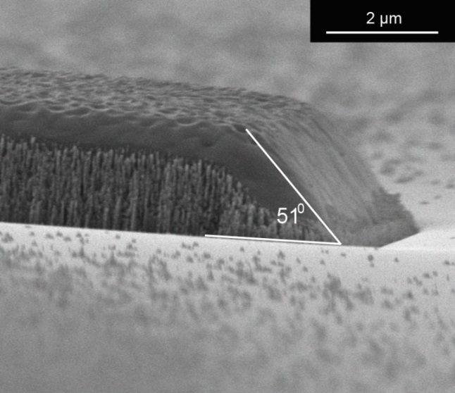
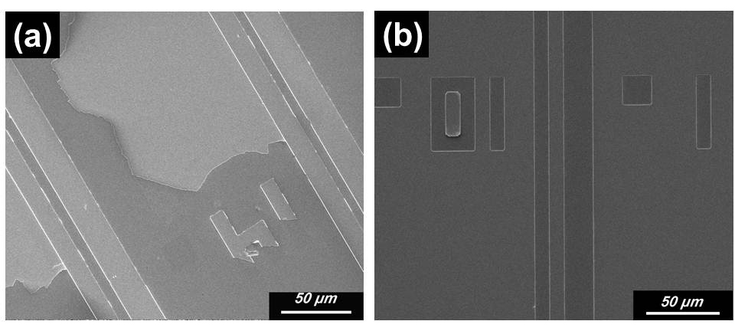
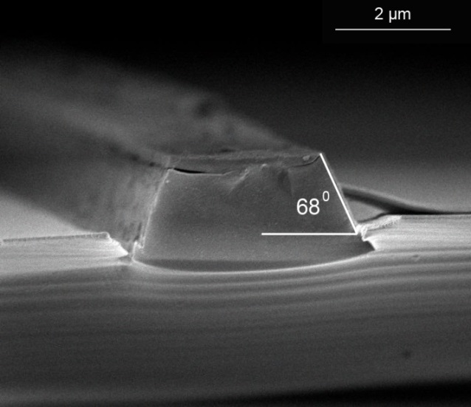
Lithium niobate etching in 2010

Slide 5
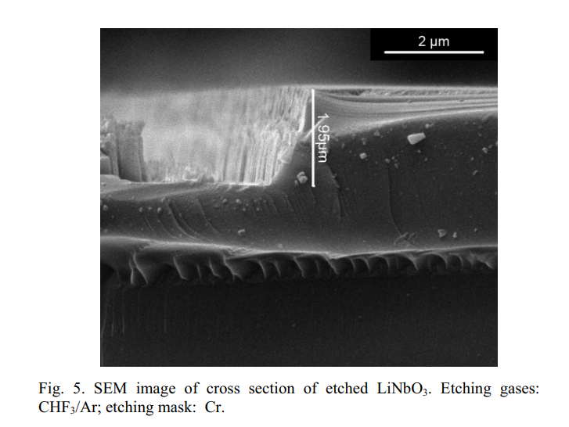
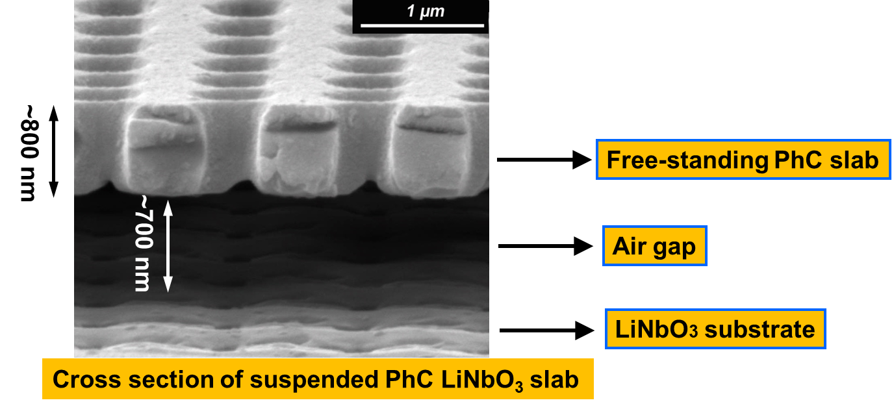
Better etching
2018
2010
2013
[1] J. Deng, G. Si and A. J. Danner, "Dry etching of LiNbO₃ using inductively coupled plasma," 2010 Photonics Global Conference, Orchard, Singapore, 2010, pp. 1-5, doi: 10.1109/PGC.2010.5706006.
[2] Jun Deng, Sajid Hussain, Vanga Sudheer Kumar, Wei Jia, Ching Eng Png, Lim Soon Thor, Andrew A. Bettiol, and Aaron J. Danner, "Modeling and experimental investigations of Fano resonances in free-standing LiNbO₃ photonic crystal slabs," Opt. Express 21, 3243-3252 (2013)
[3] S. Y. Siew, E. J. H. Cheung, H. Liang, A. Bettiol, N. Toyoda, B. Alshehri, E. Dogheche, and A. J. Danner, “Ultra-low loss ridge waveguides on lithium niobate via argon ion milling and gas clustered ion beam smoothening,” Opt. Express, vol. 26, no. 4, pp. 4421–4430, Feb. 2018.

Slide 6
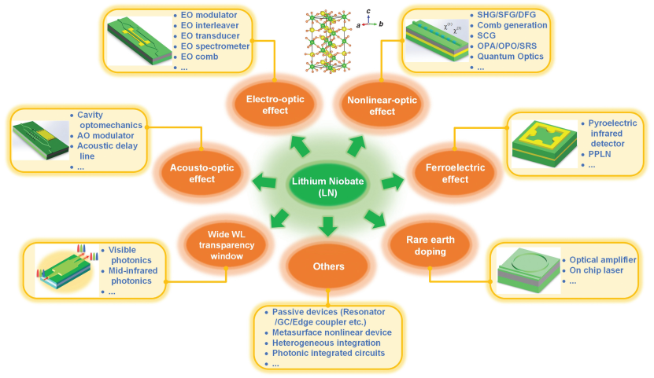
Applications
01
Advanced Photonics 4.3 (2022): 034003.

Slide 7
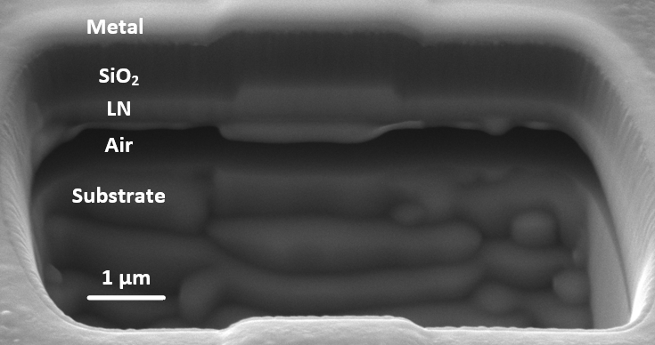
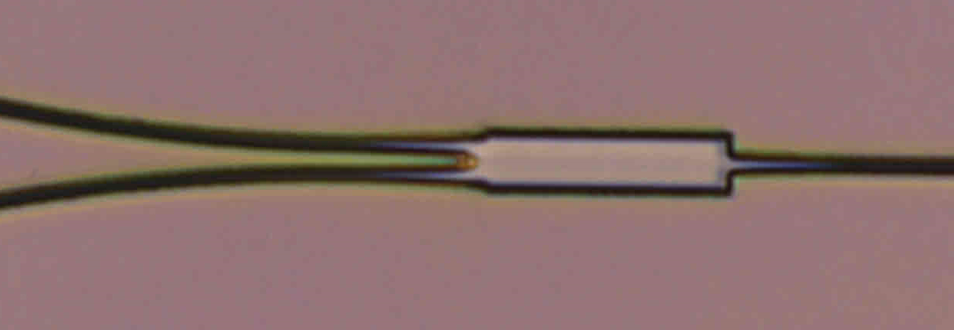
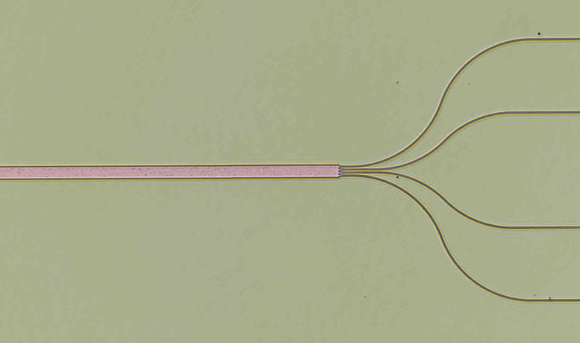
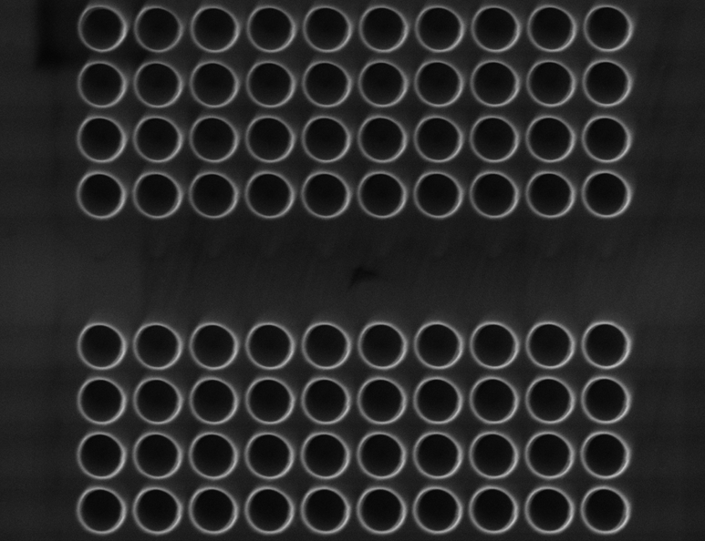
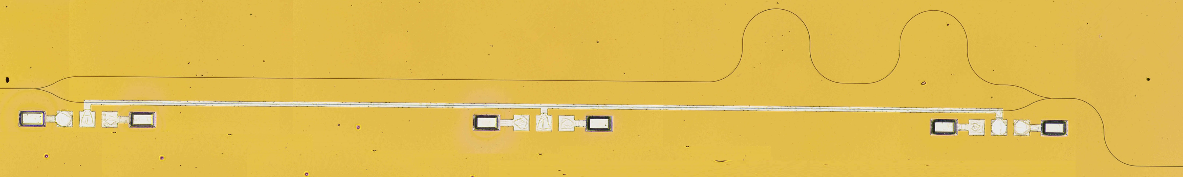
Thin film lithium niobate devices in our lab
Waveguide
Cross-section
Air bridge
1 by 2 MMI
4 by 4 MMI
Photonic crystal
Z-cut modulator

Slide 8
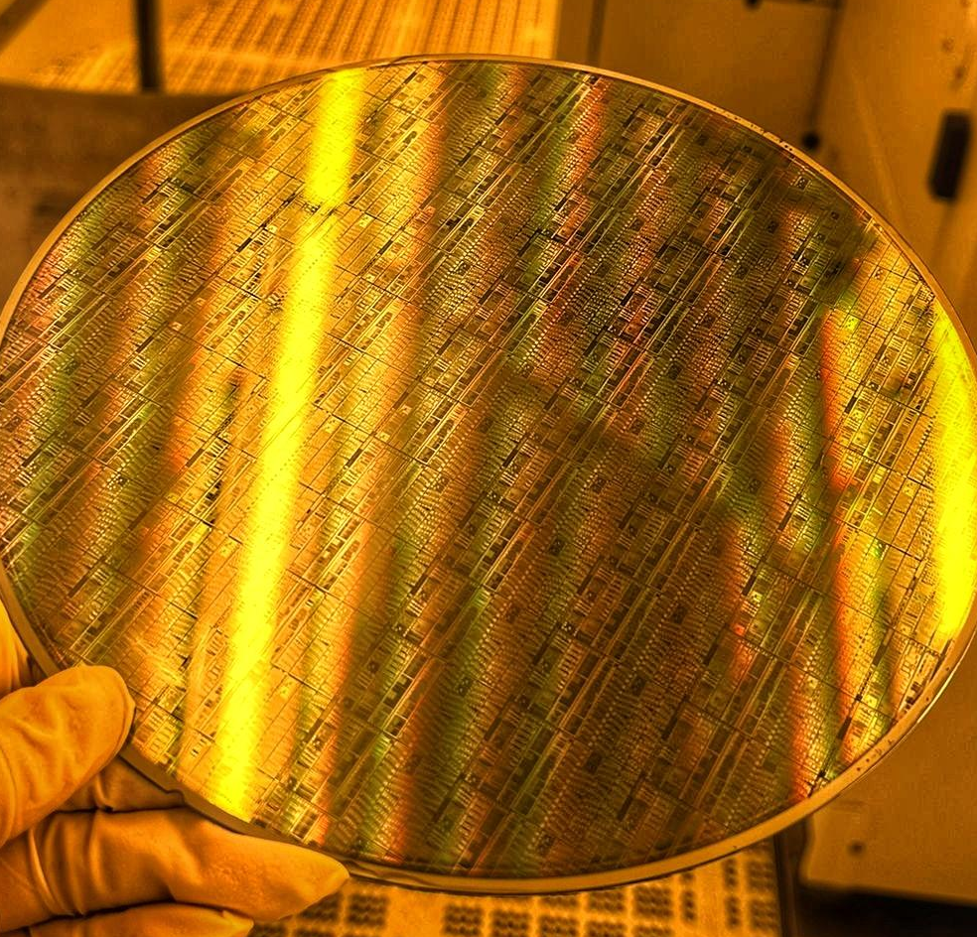
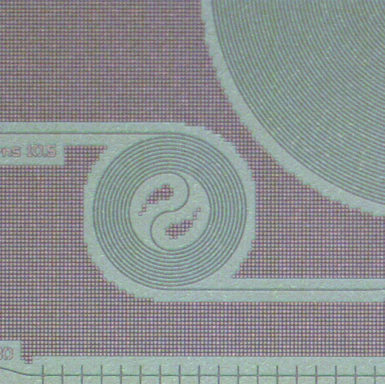
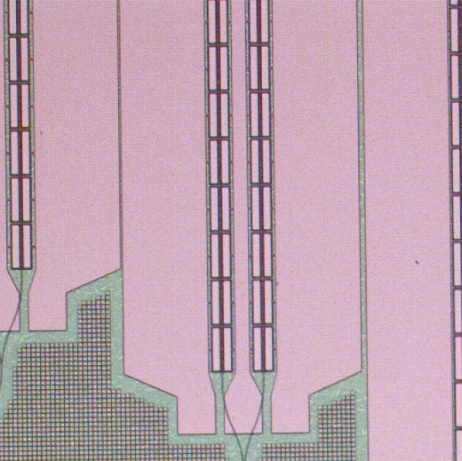
8-inch Thin-Film Lithium Niobate Platform
– Towards extremely high-speed modulators
8-inch wafer-level TFLN fabrication process and PDK development
Photonics heterogeneous integration of TFLN modulator on silicon photonics platform through die-to-wafer (D2W) bonding.
Contact: Dr. Xianshu Luo, Luo_Xianshu@ime.a-star.edu.sg

Slide 9
Lithium niobate compared to other materials

Slide 10
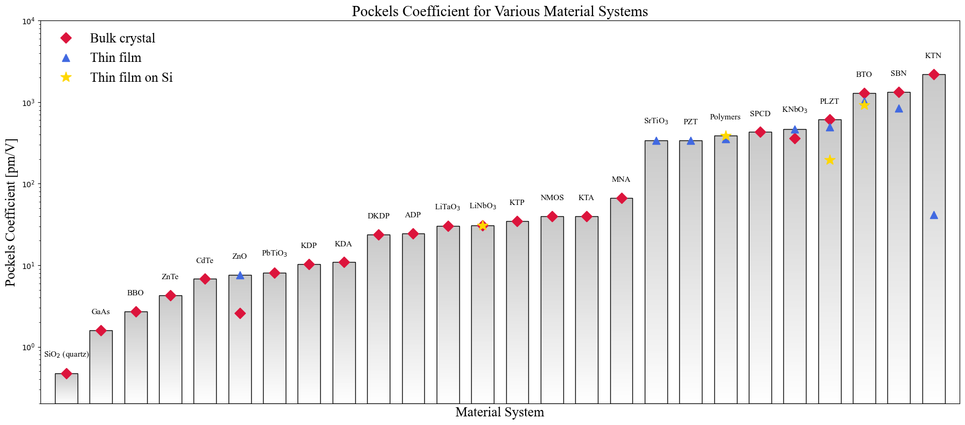
Pockels Coefficients for Various Material Systems [updated, April 2025]
10⁴
KTN
Pockels Coefficient [pm/V]
BTO
SBN
PLZT
10³
Polymers
KNbO₃
SPCD
PZT
MNA
10²
LiTaO₃
LiNbO₃
KTA
DKDP
ADP
KTP
PbTiO₃
KDA
_{CdTe}
_{ZnO}
KDP
10¹
_{ZnTe}
BBO
GaAs
10⁰
SiO₂
Material
Chart made by Wang Zexian, Ph.D. student

Slide 11
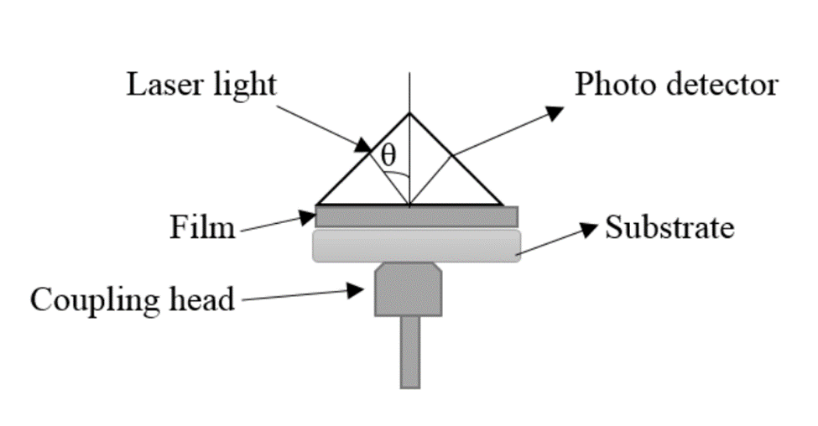
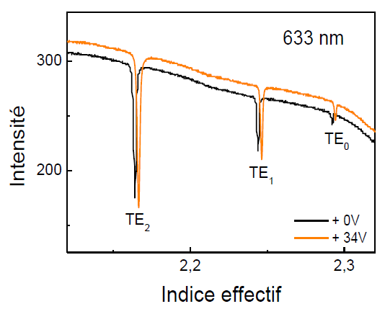
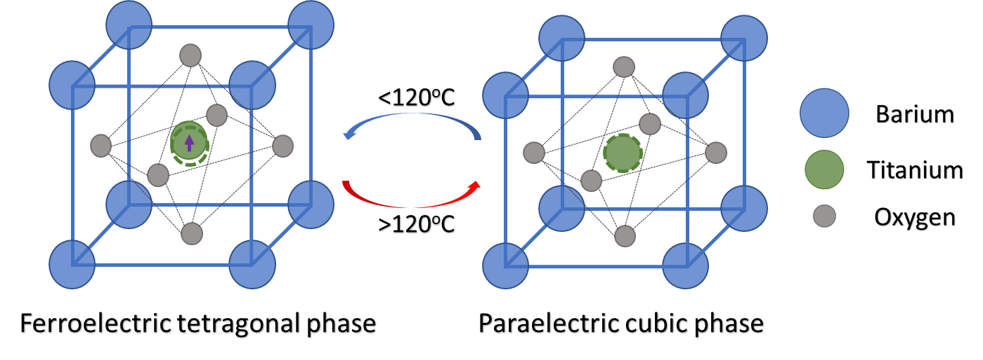
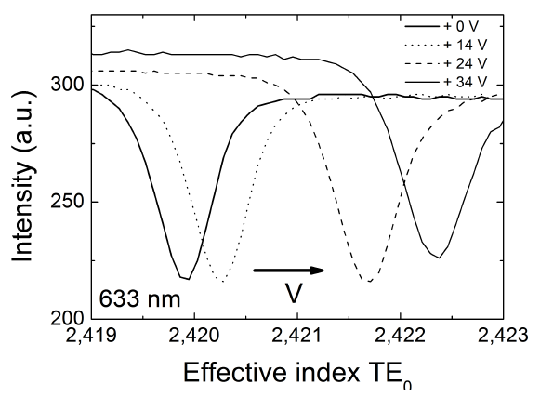
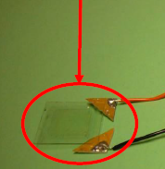
Encouraging Early Results in Literature:
Polycrystals of Barium Titanate (BTO)
Key Challenge:
Bulk BTO
Structural phase transition at 120°C can crack the crystal in fabrication processes such as etching or baking
The ion diffusion method which is used in lithium niobate modulator fabrication may not be possible for BTO
r13 = 18 pm/V, r33= 23 pm/V
Leroy, F. et al. Guided-wave electro-optic characterization of BaTiO₃ thin lms using prism coupling technique Opt. Lett. 38, 1037–1039 (2013).
A. Petraru et al., ‘’Integrated optical Mach–Zehnder modulator based on polycrystalline BaTiO₃.’’ Opt. Lett. 28,2527 (2003)
reff = 22 pm/V

Slide 12
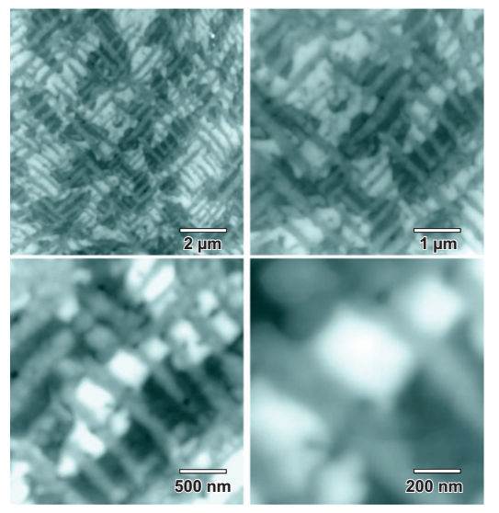
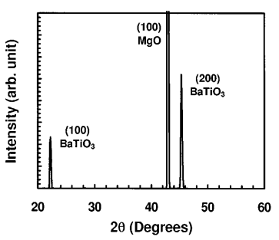
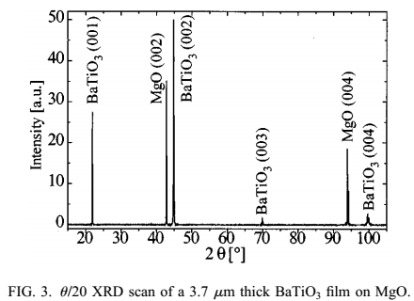
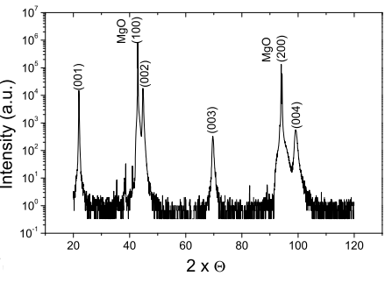
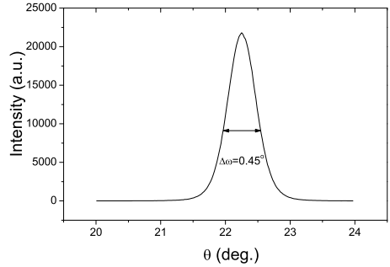
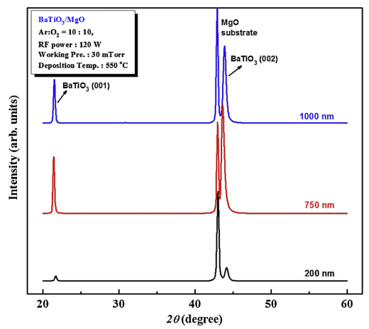
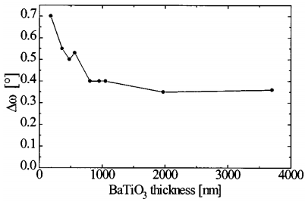
Historical Perspective: BTO on MgO
MgO has a relatively small lattice mismatch of 5% and a low refractive index of 1.71.
Multi-domain
BTO/MgO
B. Wessels, ‘‘Ferroelectric Epitaxial Thin Films for Integrated Optics.’’ Annu. Rev. Mater. Res. 37, 659–79 (2007)
FWHM
= 0.6
FWHM =
0.45
FWHM=0.8097
r₄₂=110 pm/V
D. H. Kim and H. S. Kwok, ’’Pulsed laser deposition of BaTiO₃ thin films and their optical properties’’ Appl. Phys. Lett. 67, 1803 (1995)
FWHM > 0.36
Desired region
A. Petraru, ‘’Optical and electro-optical properties of BaTiO₃ thin films and Mach-Zehnder waveguide modulators’’, PHD Thesis. Universitat zu Koln (2003)
Il-Doo Kim, ‘’Ridge waveguide using highly oriented BaTiO3 thin films for electro-optic application’’ Journal of Asian Ceramic Societies 2, 231–234 (2014)
L. Beckers et al., ‘’Structural and optical characterization of epitaxial waveguiding BaTiO₃ thin films on MgO’’ Journal of Applied Physics 83, 3305 (1998)
Notes:
MgO have a relatively small lattice mismatch with BTO. Normally BTO electro- optic modulators are fabricated on MgO. However, MgO has comparably large lattice mismatch with BTO and MgO is hydrophilous thus having a poor surface. Therefore BTO either grow a-c domains or single crystals but orientation wide spread.

Slide 13
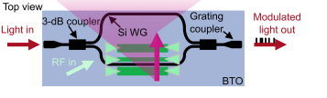
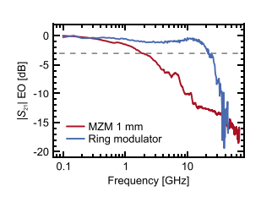
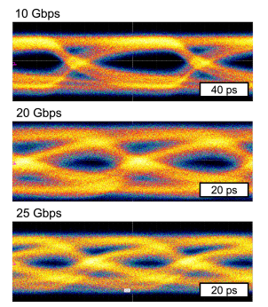
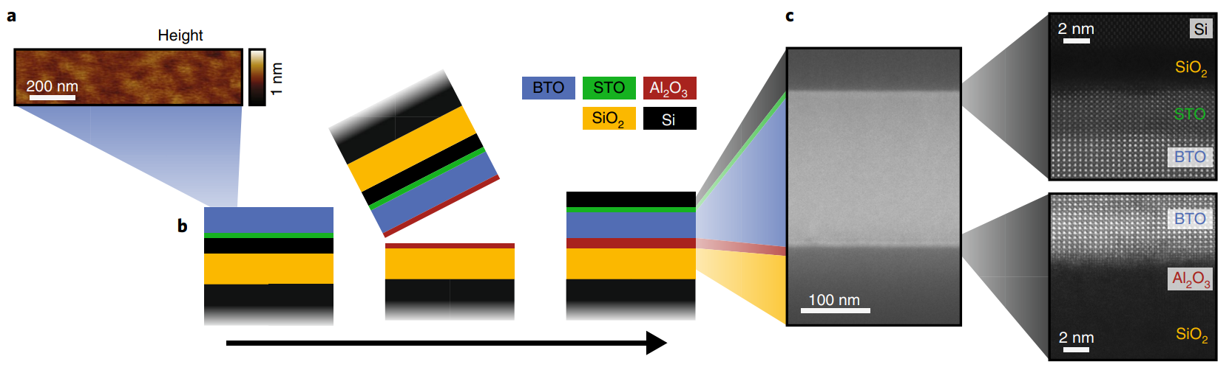
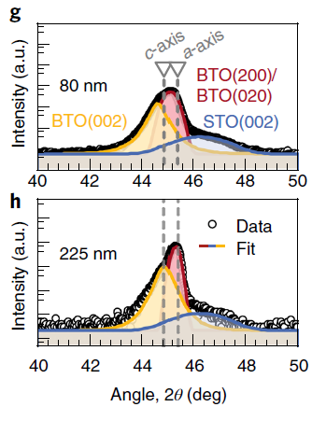

Reported Barium Titanate (BTO) modulators and structures
Thin film BTO
BTO thin film
Such as MgO , SiO₂ , …
To provide vertical confinement
Low index substrate
a-c domain structure
Largest r reported in thin film
$r_{eff}$ = 900 pm/V
Felix Eltes et al., J. of Lightwave Tech., Vol. 37, No. 5 (2019)
S. Abel, Nature Materials 18(1), 42–47 (2019).
Notes:
This is really large r value achieved for multi-domain BTO thin film.

Slide 14
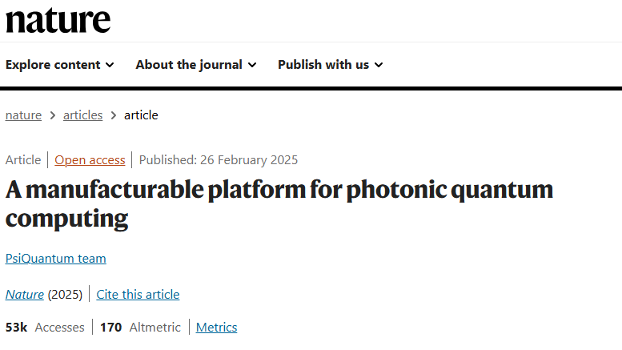
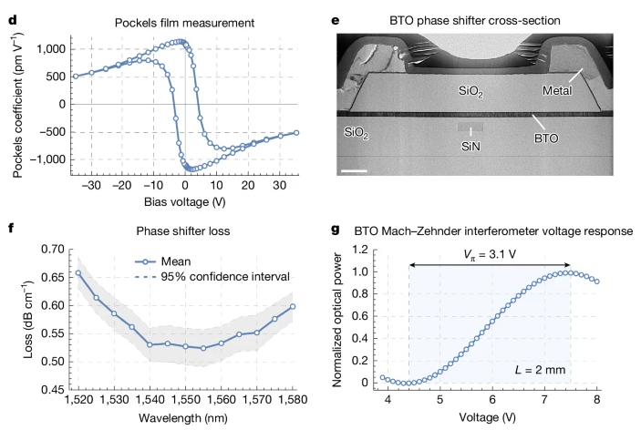
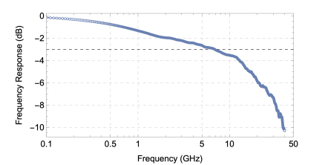
PsiQuantum’s BTO device
PsiQuantum team. A manufacturable platform for photonic quantum computing. Nature (2025). https://doi.org/10.1038/s41586-025-08820-7

Slide 15
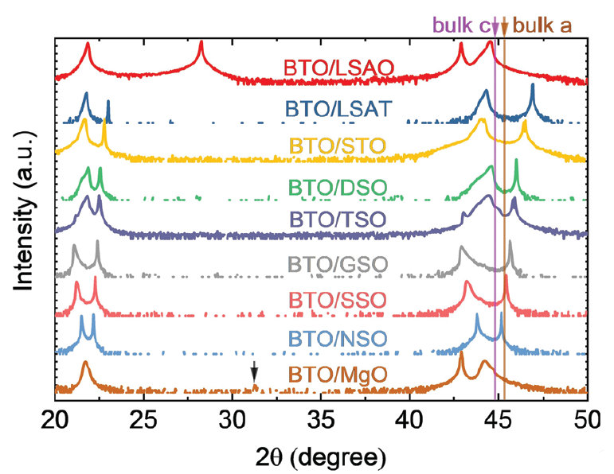
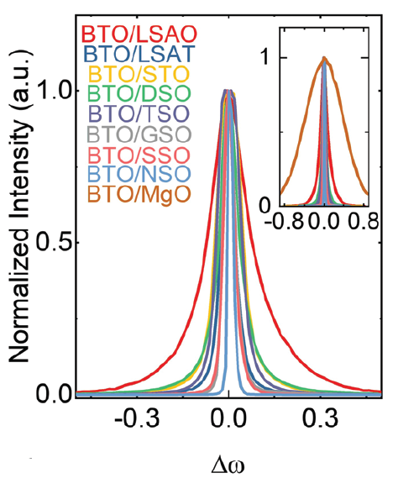
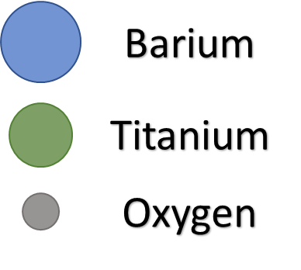
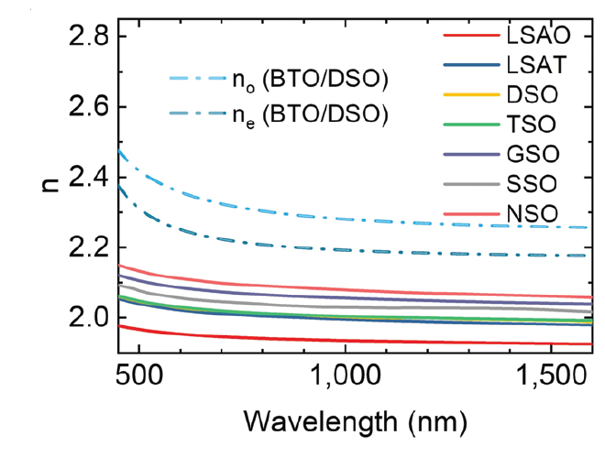
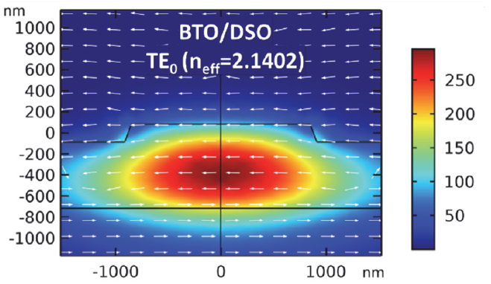



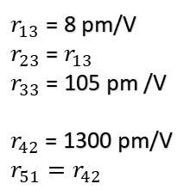

Barium Titanate (BTO) single crystal properties
Bulk BTO
Thin film BTO on low-index insulator
BaTiO₃ crystal
Small lattice mismatch
z
y
x
x y z
$$0$$
$$0$$
$$r_{lk}=\left[\begin{matrix}\begin{matrix} & & r_{13} \\ & & r_{23} \\ & & r_{33}\end{matrix} \\ \begin{matrix} & r_{42} & \\ r_{51} & & \\ & & \end{matrix}\end{matrix}\right]$$
$r_{13}$ = 8 pm/V
$r_{23}$ = $r_{13}$
$r_{33}$ = 105 pm /V
$r_{42}$ = 1300 pm/V
$$r_{51}=r_{42}$$
Vertical mode confinement
$$0$$
$$0$$
$$0$$
$$0$$
$$0$$
$$0$$
$$0$$
$$0$$
$$0$$
$$0$$
$$0$$
λ = 1550 nm
A. Petraru et al., ‘’Integrated optical Mach–Zehnder modulator based on polycrystalline BaTiO₃,’’ Opt. Lett. 28,2527 (2003)
Leroy, F. et al. “Guided-wave electro-optic characterization of BaTiO₃ thin films using prism coupling technique,” Opt. Lett. 38, 1037–1039 (2013)
L. Beckers et al., ‘’Structural and optical characterization of epitaxial waveguiding BaTiO₃ thin films on MgO,’’ Journal of Applied Physics 83, 3305 (1998)
Il-Doo Kim, ‘’Ridge waveguide using highly oriented BaTiO₃ thin films for electro-optic application,’’ Journal of Asian Ceramic Societies 2, 231–234 (2014)
B. Wessels, ‘‘Ferroelectric Epitaxial Thin Films for Integrated Optics,’’ Annu. Rev. Mater. Res. 37, 659–79 (2007)
M. Yashima et al., “Size effect on the crystal structure of barium titanate nanoparticles,” J. Appl. Phys., 98(1), 14313 (2005)
P. Girouard, “χ(2) Modulator With 40-GHz Modulation Utilizing BaTiO₃ Photonic Crystal Waveguides,” IEEE J. Quantum Electron., 53(4), 1–10, (2017)
S. Abel, "Large Pockels effect in micro- and nanostructured barium titanate integrated on silicon," Nature Materials 18(1), 42–47 (2019).
Advanced Materials, 33 (37), 2101128 (2021)

Slide 16
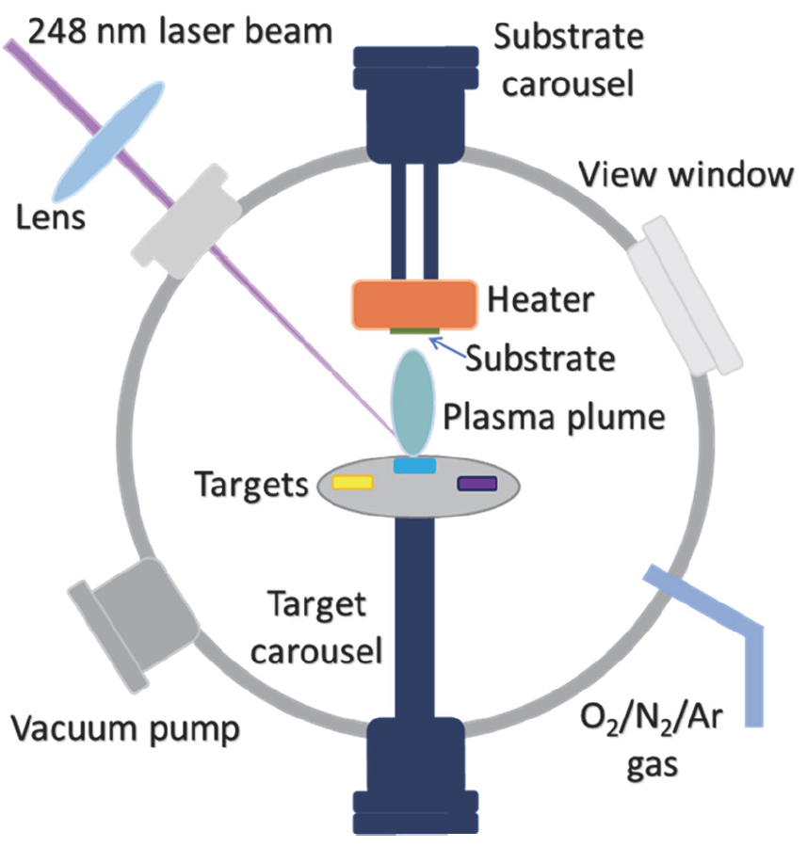
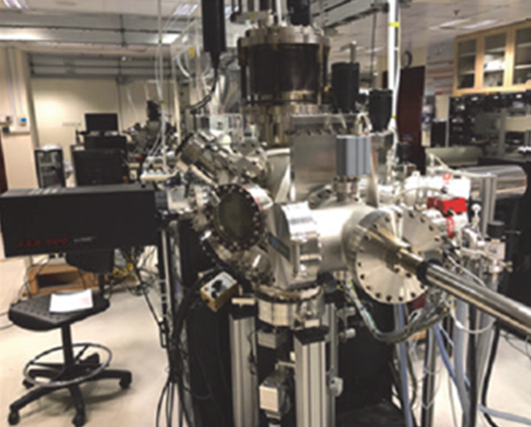
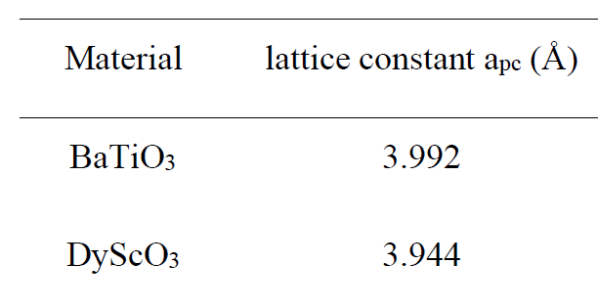
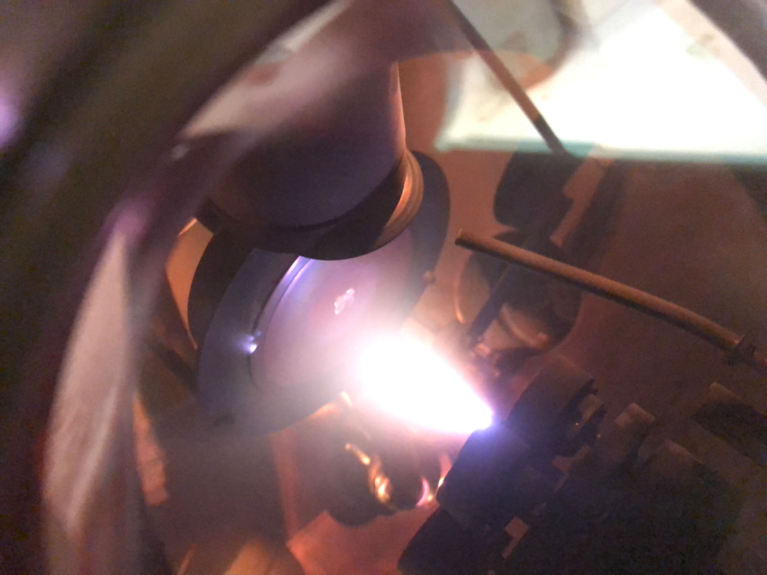
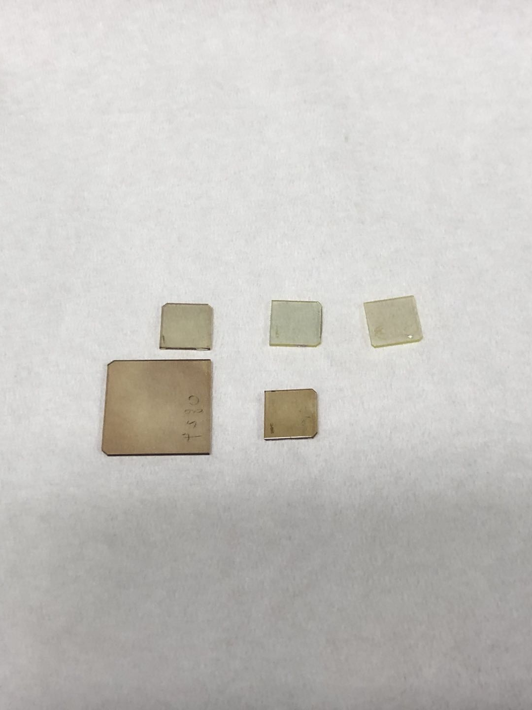
1. BTO thin film on DSO substrate
Substrate choice
Growth
Good lattice match
Pulsed laser deposition (PLD)
Smaller refractive index
Material | Refractive index
BaTiO₃ | ~2.2
DyScO₃ | ~2
10 mm
Plasma plume for BTO growth

Slide 17


High quality single crystal BTO (001) and flat surface achieved at thicknesses required for optical modes.
c axis oriented out of plane
AFM morphology of BTO surface of 600 nm BTO/DSO with small rms roughness of 746.2 pm.
AFM morphology of BTO surface of 600 nm BTO/DSO with small rms roughness of 746.2 pm.
XRD 2θ-ω coupled scan shows a single orientation of BTO (001), with c-axis out of plane.
XRD Δω scan at BTO (002) shows highly oriented film, with FWHM of 0.075º, indicating high crystal quality.
Notes:
We know that rough surfaces scatters lights out from the waveguides, causing a lot of loss. Therefore, a smooth surface would be necessary. With the thickness of 600 nm of BTO films, the surface maintains flat and the AFM image show a small rms roughness of less than 1 nm.
XRD 2θ-ω coupled scan shows that c-axis BTO single orientation, no other orientation out of plane is observed.
XRD Rocking curve scan show the distribution of c-orientation, FWHM of 0.075º at the BTO (002) indicates high crystal quality.
The XRD data comes from the fabricated device, it reflects our fabrication process did not lower the crystal quality.
(FYI, rocking curve FWHM at (001) is not comparable, and is normally half of it at (002).)

Slide 18




Increased Tc and High temperature phase stability
Hysteresis
Bulk BTO
Coercive field = 496 kV/cm
Thin film BTO on DSO
Helium-ion microscope picture of a well-etched sample surface
No structural phase transition observed at up to 700°C
Advanced Materials, 33 (37), 2101128 (2021)
Notes:
Volume V = a*b*c

Slide 19











Pockels matrix of BTO thin film grown on DyScO₃ (DSO) substrate
Refractive index change with DC voltage applied (λ = 636.6 nm)
$$r_{13}$$
$$r_{23}$$
$$r_{33}$$
Sample: IBSD
Electric field is applied along the z direction
Degraded crystal quality compared with BTO on DSO
x y z
$$0$$
$$0$$
$$r_{lk}=\left[\begin{matrix}\begin{matrix} & & r_{13} \\ & & r_{23} \\ & & r_{33}\end{matrix} \\ \begin{matrix} & r_{42} & \\ r_{51} & & \\ & & \end{matrix}\end{matrix}\right]$$
$r_{13}$ = 4.2 pm/V
$r_{23}$ = 4.6 pm /V
$r_{33}$ = 9.0 pm/V
$$0$$
$$0$$
$$0$$
$$0$$
$$0$$
$$0$$
$$0$$
$$0$$
$$0$$
$$0$$
$$0$$
Optical Materials Express, 13(1), 152-160 (2023)

Slide 20







Large Pockels coefficient r₅₁ (r₄₂) in BTO on insulator
Theory: Off diagonal Pockels coefficients $r_{51}$ can rotate the optic axis
$$ε=\left[\begin{matrix}εx & 0 & {−ε}_{0}n_{x}^{2}n_{z}^{2} r_{51}E_{x} \\ 0 & εy & {−ε}_{0}n_{y}^{2}n_{z}^{2} r_{42}E_{y} \\ {−ε}_{0}n_{x}^{2}n_{z}^{2} r_{51}E_{x} & {−ε}_{0}n_{y}^{2}n_{z}^{2} r_{42}E_{y} & εz\end{matrix}\right]$$
An active polarization rotator
Simulated
x y z
Experiment (a maximum power conversion of ~30%)
$$0$$
$$0$$
$$r_{lk}=\left[\begin{matrix}\begin{matrix} & & r_{13} \\ & & r_{23} \\ & & r_{33}\end{matrix} \\ \begin{matrix} & r_{42} & \\ r_{51} & & \\ & & \end{matrix}\end{matrix}\right]$$
$$0$$
$$0$$
$$0$$
$$0$$
$$0$$
$$0$$
26.1 dB
$$0$$
$$0$$
$$0$$
$$0$$
$$0$$
$r_{51}$ = 600 pm/V
With TE input
With TM input
With TE input
Applied Physics Letters, 122, 031106 (2023)

Slide 21


Typical Waveguide Fabrication Procedure
Extracted r₄₂ = 1268 pm/V

Slide 22






Engineering refractive index contrast without dry etching BTO
Metal diffusion
Proton beam
Crystallinity control
(Metal diffusion like in LN is possible)
1000°C for 10 h in Ar/H₂
Air
Diffused
BTO
Diffused
h
DSO
w
RMS=13.4 nm
Mo diffused
w=0.5 µm
h = 250 nm
TM
RMS=0.2 nm
BTO
Y. Cao et al., “Engineering refractive index contrast in thin film barium titanate-on-insulator,” Nano Letters, vol. 23, 16 (2023).
1 µm
λ = 532 nm

Slide 23







Engineering refractive index contrast without dry etching BTO
Metal diffusion
Proton beam
Crystallinity control
Proton beam irradiation
Large Area Proton Beam (H⁺)
Y. Cao et al., “Engineering refractive index contrast in thin film barium titanate-on-insulator,” Nano Letters, Accepted (2023)
Crystallinity control

Slide 24
Optical computing with Lithium Niobate

Slide 25












Matrix-vector multiplication using optics
$$\left[\begin{matrix}sin θ & cos⁡θ \\ \cos{θ} & −sin θ\end{matrix}\right]∙\left[\begin{matrix}E_{1} \\ E_{2}\end{matrix}\right]=\left[\begin{matrix}E_{1}sin θ+E_{2}\cos{θ} \\ E_{1}\cos{θ}−E_{2}sin θ\end{matrix}\right]$$
A 2-port interferometer
E₁
$−θ$ phase shift
unitary
matrix
vector
product
$θ$ phase shift
E₂
FDTD simulation for illustration
For example, if $θ$ = $0$
$\left[\begin{matrix}sin(0) & cos⁡(0) \\ cos⁡(0) & −sin(0)\end{matrix}\right]∙\left[\begin{matrix}1 \\ 1\end{matrix}\right]=$ $\left[\begin{matrix}0 & 1 \\ 1 & 0\end{matrix}\right]∙\left[\begin{matrix}1 \\ 1\end{matrix}\right]→\left[\begin{matrix}1 \\ 1\end{matrix}\right]$
$$0$$
$$0$$
For example, if $θ$ = $−π/4$
$\left[\begin{matrix}sin(−π/4) & cos({−π/4}) \\ cos⁡(−π/4) & −sin⁡(−π/4)\end{matrix}\right]∙\left[\begin{matrix}1 \\ 1\end{matrix}\right]=$ $\left[\begin{matrix}−\frac{1}{\sqrt{2}} & \frac{1}{\sqrt{2}} \\ \frac{1}{\sqrt{2}} & \frac{1}{\sqrt{2}}\end{matrix}\right]∙\left[\begin{matrix}1 \\ 1\end{matrix}\right]→\left[\begin{matrix}0 \\ \sqrt{2}\end{matrix}\right]$
45$$
$$−45$$
Reck, M., et al., Experimental realization of any discrete unitary operator. Physical Review Letters, 1994. 73(1): p. 58-61.
Clements, W.R., et al., Optimal design for universal multiport interferometers. Optica, 2016. 3(12): p. 1460.
Xu, X.-Y., et al., A Reconfigurable Photonic Processor for NP-complete Problems. arXiv preprint arXiv:2308.14156, 2023.

Slide 26

Arbitrarily large matrices are possible
2 x 2 optical matrix multiplier
Functional Block
$−θ$ phase shift
2 x 2
$θ$ phase shift
3 x 3 optical matrix multiplier
Functional Block
2 x 2
3 x 3
2 x 2
2 x 2
Notes:
After explaining the 2by2 interferometer, let’s move to the 3x3 condition. If we put three 2by2 interferometer in this way, we will get the 3x3 interferometer. And this structure could represent any unitary matrix.
Some additional structure is added to make up the difference of optical speed at different part of structure.
Total length is about 100 microns. For a 0.5cmx0.5cm wafer, 90x90 interferometer might be realized.

Slide 27


Example: 3 x 3 matrix multiplication
$$\left[\begin{aligned}any 3x3 \\ unitary \\ matrix\end{aligned}\right]∙\left[\begin{matrix}E_{1} \\ E_{2} \\ E_{3}\end{matrix}\right]$$
Input 1
Output 1
Input 2
Output 2
Input 3
Output 3
Notes:
Finite-Difference Time-Domain method
Then I did Lumerical simulation for this structure to verify the theory.

Slide 28






Example: 3 x 3 matrix multiplication
$$\left[\begin{matrix}1 & 0 & 0 \\ 0 & \frac{1}{\sqrt{2}} & −\frac{1}{\sqrt{2}} \\ 0 & \frac{1}{\sqrt{2}} & \frac{1}{\sqrt{2}}\end{matrix}\right]∙\left[\begin{matrix}1 \\ 1 \\ 1\end{matrix}\right]$$
$$=\left[\begin{matrix}1 \\ 0 \\ \sqrt{2}\end{matrix}\right]$$
Input 1
Output 1
$$θ_{1}=−\frac{π}{2}$$
$$θ_{2}=+\frac{π}{2}$$
Input 2
Output 2
$$θ_{3}=−\frac{π}{4}$$
Input 3
Output 3
Notes:
Finite-Difference Time-Domain method
Then I did Lumerical simulation for this structure to verify the theory.

Slide 29




Scalability and speed
How can we handle
non-unitary matrices?
(singular value decomposition)
$$T=U⋅Σ{⋅V}^{T}$$
any
matrix
unitary
matrix
unitary
matrix
1 mm
In lithium niobate,
$$\text{}t \sim \frac{∆L∙n}{c}\sim 8 ps$$
If N x N increases to (N+1) x (N+1), then
The calculation time increases by $\text{}t$
(SPEED IS LINEAR WITH N)
The chip area increases by 2N
All-to-all connectivity is maintained
diagonal
matrix
For a 100 x 100 matrix,
$t \sim 800 ps$

Slide 30

Chip-based 2x2 design
AM
PM
SP
Port 1
SP
SP
Port 2
AM
PM
AM
SP
Port 3
SP
MZI
MZI
SP
Port 4
AM
PM
AM
SP
SP
Port 5
AM
PM
SP
Port 6
AM
Amplitude Modulator
Waveguide
PM
G
Phase Modulator (EO)
SP
1-by-2 50:50 MMI or y-branch
SP
S
SP
G

Slide 31




Silicon photonics matrix-vector multiplier
Thermo-Optic Modulator
Laser Input
2x2 MMI
MZI
MZI
1x2 MMI
PD
Zoomed
in
Modulation Speed: limited to kHz
Footprint: 1.65 mm²

Slide 32







Lithium niobate version
Collaborator: Fabricated by Prof. Ya Cheng, East China Normal University
SP
SP
SP
MZI
MZI

Slide 33







Nonlinear Operation: Periodical Poling on Lithium Niobate Nanophotonic Waveguide
Pump Depleted SHG [1]
50 μm
Fabricated by
Zhu Di, NUS
Resemblance to Sigmoid Curve [2]
b
$output$
Ideal
Experimental
$O$
$input$
[1] X. Shi, D. Zhu, et al. "Efficient photon-pair generation in layer-poled lithium niobate nanophotonic waveguides." Light: Science & Applications 13.1 (2024): 282.
[2] F. Fu, et al., arxiv.org/abs/2504.18145

Slide 34


Optical Computing Verification I
Optical Neural Network Architecture
Results

Slide 35
Ising Machines

Slide 36








What is an Ising computer ?
$$σ_{n}$$
$$σ_{1}$$
Task: Minimize $ℋ$ with $σ=±1$
$$J_{12}$$
$$ℋ=\sum_{m,n}{J_{mn}σ_{m}σ_{n}}$$
$$σ_{2}$$
We seek a physical system which naturally tends to reach the lowest energy state.
Quantum Annealing
Machine Learning and Computer Science
Healthcare &
Medicine
Optimisation
Financial Modelling
What problems do an Ising computer solve?

Slide 37

“+1” set
“-1” set
“+1” set
“-1” set
“+1” set
“-1” set
“+1” set
“-1” set

Slide 38







What does an Ising computer do physically?
+1
(our group’s simulations)
A 100-bit annealer
Task: Minimize $ℋ$ with $σ=±1$
1 1 1 1 1 1 1 1 1 1
1 1 1 1 1 1 1 1 1 1
1 1 1 1 1 1 1 1 1 1
1 1 1 1 1 1 1 1 1 1
1 1 1 1 1 1 1 1 1 1
1 1 1 1 1 1 1 1 1 1
1 1 1 1 1 1 1 1 1 1
1 1 1 1 1 1 1 1 1 1
1 1 1 1 1 1 1 1 1 1
1 1 1 1 1 1 1 1 1 1
$$ℋ=\sum_{m,n}{J_{mn}σ_{m}σ_{n}}$$
We seek a physical system which naturally tends to reach the lowest energy state.
-1
(time)
Simulations based on algorithm in:
Böhm, F., Verschaffelt, G. & Van der Sande, G. A poor man’s coherent Ising machine based on opto-electronic feedback systems for solving optimization problems. Nat Commun 10, 3538 (2019). https://doi.org/10.1038/s41467-019-11484-3

Slide 39



Examples of excellent existing Ising computers
https://www.dwavequantum.com/
https://www.fujitsu.com/global/services/business-services/digital-annealer/

Slide 40






Non-photonic Ising machines
Introduction
Chip Design
Results
Outlook
Memristors Crossbar-Matrix-Multiply Unit
Nat. Electron. 3. (2020):409
Scalable CMOS Ising Machine
IEEE Journal of Solid-State Circuits 57.3 (2022): 858
Quantum Annealer
(D-Wave)
Nature Physics 10.3 (2014): 218
48-node All-to-All CMOS Ising Machine
Nat. Electron. 6.10 (2023):771
Stochastic Magnetic Tunnel Junctions Based P-Bit Circuit
Nature 573. (2019): 390
Optoelectronic Parametric Oscillator (OEPO)
Light: Science & Applications, 11.1 (2020): 333
Notes:
Ising machine is widely studied and constructed on various physical system.

Slide 41









Photonic Ising machines
Introduction
Chip Design
Results
Outlook
Free Space OPO
Nat. Photo. 8. 12 (2014):937
Fiber Optics OPO
Science 354.6312 (2016): 614
Opto-electronic oscillator
Nat. Com. 10.1 (2019): 3538
Integrated OPOs on SiN
Nat. Com. 11.1 (2020): 4119
Integrated MZI
Optica 7.5 (2020): 551
Integrated OPOs on LN
arXiv: 2405.17355 (2024)
All-Optical Interferometer-Based Ising Machine
Manuscript accepted by Optica
Integrated MZI
Nature 640.8058 (2025): 361
Additional Reference:
Applied Physics Reviews 11.4 (2024)
Notes:
In the photonic area, it is also widely studied like……
For more photonic Ising machines, we recently published a review about them for your reference.

Slide 42


















Working Principle
Matrix Multiplication
Nonlinear Operation
$σ_{n}\left[k+1\right]=\cos^{2}{(f_{n}\left[k\right]−\frac{π}{4}+noise)}−\frac{1}{2}$
$f_{n}\left[k\right]=ασ_{n}\left[k\right]+β\sum_{m}{J_{mn}}σ_{m}\left[k\right]$
Purpose: Realize Ising Machine in Optical Domain
$\cos^{2}$ (equation 1) $→$Photodetection
Linear operation (equation 2) $→$ MZI
(1)
For example, with three spins:
$\left[\begin{matrix}f_{1}\left[k\right] \\ f_{2}\left[k\right] \\ f_{3}\left[k\right]\end{matrix}\right]=α\left[\begin{matrix}σ_{1}\left[k\right] \\ σ_{2}\left[k\right] \\ σ_{3}\left[k\right]\end{matrix}\right]+β\left[\begin{matrix}J_{11} & J_{12} & J_{13} \\ J_{21} & J_{22} & J_{23} \\ J_{31} & J_{32} & J_{33}\end{matrix}\right]×\left[\begin{matrix}σ_{1}\left[k\right] \\ σ_{2}\left[k\right] \\ σ_{3}\left[k\right]\end{matrix}\right]$
(2)
$$=\left[\begin{matrix}α & βJ_{12} & βJ_{13} \\ βJ_{21} & α & βJ_{23} \\ βJ_{31} & βJ_{32} & α\end{matrix}\right]×\left[\begin{matrix}σ_{1}\left[k\right] \\ σ_{2}\left[k\right] \\ σ_{3}\left[k\right]\end{matrix}\right]$$
&
$$J$$
$$σ$$
$$f_{sub1}$$
$$J_{sub1}$$
$$σ_{sub1}$$
$$J_{sub2}$$
$$σ_{sub1}$$
$$f_{sub2}$$
$$J_{sub3}$$
$$σ_{sub3}$$
$$J_{sub4}$$
$$σ_{sub4}$$
[1] Böhm, F., Verschaffelt, G. & Van der Sande, G. Nat Commun 10, 3538 (2019).
[2] Lan et al., 5, 2400004 (2024).
$$σ_{t+1}=f\left(σ_{t}\right)$$
$$f\left(σ_{t}\right)=\left(ασ_{t}+βJσ_{t}\right){∙e}^{\left(−{\left(ασ_{t}+βJσ_{t}\right)}^{2}\right)}$$
(alternative optical algorithms are available too)

Slide 43



Free Space All-Optical Ising Machine
Matrix Multiplication
Nonlinear operation

Slide 44







Experimentally solving a 1024-spin square lattice
x10
x10
100 Spins (Square Lattice)
1024 Spins (Square Lattice)
To be published (Optica)
Notes:
Iteration Speed per round: 0.6 second

Slide 45



Photographs of the Ising Machine in action
Footprint: 2 m²
10 ns optical calculation speed (per iteration), but 0.6 s including I/O

Slide 46



$≈$50,000-spin problem solving (silicon chip)
49,284 Spin Problem
x222
x222
Comparing to simulated annealing running on advanced CPU: Intel Core i9-13900k
Over 440 iterations: 212x better solution
Both running for 150 mins: 9x better solution
Notes:
These 50,000 spins are places as a 222x222 arrays. Each spin has a antiferromagnetic interaction with its four neighbours.
The graph in the middle illustrate the energy landscape of our system. Where we can it start from a random state, and gradually reach 97 percent of the global minimum.
If we compare the efficiency, both in 440 iteations, we reached 200x lower energy.
If we compare the speed, in 150 mins, we also reach 9 times lower energy.

Slide 47
Solving MAXCUT problems
Low density graph: Able to outperform Simulated Annealing
SA: Starting at 100° and cooling 1% per iteration
CUT Score of SPINIC (reg-4-100)
CUT Score of SA (reg-4-100)
High density graph:
Similar solution quality
as Simulated Annealing
(Hamlib dataset)
CUT Score of SPINIC (gnp-k4-100)
CUT Score of SA (gnp-k4-100)
47
Notes:
We also solve two 100-node MAXCUT problems with different complexity.

Slide 48
Perspective among the best Ising machines
Category | Type | Key Component | Footprint | Maximum Experimental Spin Count | All-to-All Connection
CMOS Annealing Processor [1] | Electronics | SRAM | 23.65 mm² | 30k | No
CMOS Chip Based Ising Machine [2] | Electronics | Oscillator | 1.8 mm² | 48 | Yes
Quantum Photonic Microprocessor [3] | Integrated Photonics | MZI | 15 mm² | 16 | …
Nanophotonic Parametric Oscillators [4] | Integrated Photonics | OPO | … | 70 | Yes
Coherent Ising Machine [5] | Fiber Optics | OPO | … | 100k | Yes
This Work | Integrated Photonics | MZI | 1.65 mm² | 50k | Yes
References:
[1]: IEEE Journal of Solid-State Circuits 55, 145-156 (2020)
[2]: Nat. Electron. 6, 771-778 (2023)
[3]: Laser & Photonics Review 18, 2300304 (2024)
[4]: arXiv.2405.17355 (2024)
[5]: Sci. Adv. 7, eabh0952 (2021)
Notes:
Here is a table comparing our system with the best ising machines, no matter it is cmos or photonic based. Specifically, our system has the smallest reported footprint since we need a 2x2 MZI only. Meanwhile, we have the second best experimental spin count due to our great scability. The only one beat us is a fiber-optics based ising machine and they use a 5km fiber, but we are a small photonic chip. Comparing with the ising chip, we have the most spin count.

Slide 49





FPGA based test scheme
Introduction
Chip Design
Results
Outlook
Amplifiers
FPGA
Laser Source
1550 nm
LN
chip
Fiber array
Probe
PD
PD
PD
PD
Electrodes
A/D
Zmod DAC (>1 MHz)
D/A
PD
Data Process and Storage
Zmod ADC
Packaged LN Chip
(high-bandwidth SZG connector)
(ZYNQ 7020 series * 2)
Pmod DAC (<1 kHz)

Slide 50






Optical Computing Verification II
From pump-depleted SHG to Ising machine
Cubic Lattice Ising Model
$$f_{SHG}\left(x\right)=xsech\left(κxz\right)$$
$α$: self-feedback strength
$β$: coupling coefficient
$κ$: nonlinear coupling coefficient
$z$: propagation distance
Ising System
$\frac{dx_{i}}{dt}=−x_{i}+$ $f_{SHG}\left(αx_{i}+β\sum_{j=1}^{N}{J_{ij}x_{i}}\right)$
$x$: pump power → Spin Amplitude
W. Fu, A. Danner, et al. "An Evolutionary Ising Optimization Framework for Unconstrained Binary Quadratic Programming" IEEE Transactions on Evolutionary Computation (2025).

Slide 51


Acknowledgements
Funding:
Singapore National Research Foundation (NRF-CRP24-2020-0003)
We are looking for postdocs
adanner@nus.edu.sg
http://www.youtube.com/@adanner
https://danner.group

